Slide 1
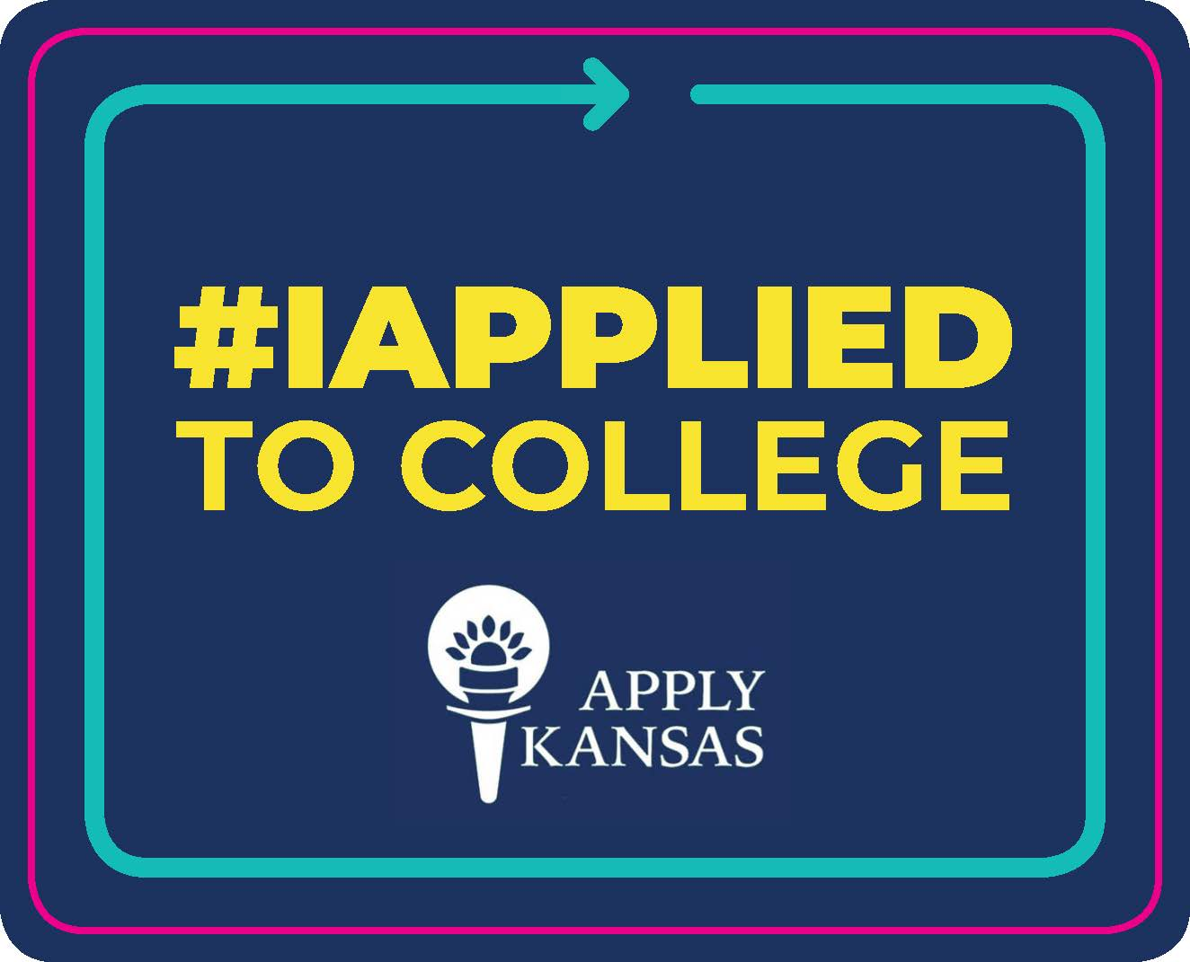
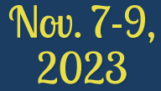
Kansas APPLY Free Days
Which Kansas Residents are Eligible?
First time Freshman? Yes
Adult Learners? Yes
Students on F/R Lunch? Yes
Students not on F/R Lunch? Yes
Transfer & Returning Students? Yes
Students applying for certificate programs? Yes
Students applying for nursing programs (mid-degree)? No
Students applying for graduate programs? No
New this Year!
Kansas Residents who wish to seek admission to a Kansas public or private* college or university are eligible to submit undergraduate or general admission applications for free on Nov. 7-9, 2023.
*some for-profit Kansas private colleges may choose not to participate
Notes:
Tara

