Slide 1
KANSAS HIGH SCHOOL ENROLLMENT IN PUBLIC POSTSECONDARY INSTITUTIONS REPORT

Slide 2
SOURCES
Kansas Higher Education Statistics
Find KHEStats at https://www.kansasregents.org/
Under the Data Tab, go to Kansas Higher Education Statistics (KHEStats)
Use the High School tab within KHEStats
System, Sector, and Institutional data are available in KHEStats

Slide 3
Notes:
For specific information on enrollments at institutions, please use the high school enrollment tab within KHEStats. Available tables and charts are listed on the left.
There are numerous filters to sort from the five drop-down menus.

Slide 4
HEADCOUNT ENROLLMENTS AY 2013-AY2018
29,512
31,248
25,678
28,216
22,719
23,938
Notes:
Looking back ten years. High school enrollment steadily increased from 2013-2018. The next slide will show that high school enrollment continued to climb until 2020, when enrollment peaked.

Slide 5
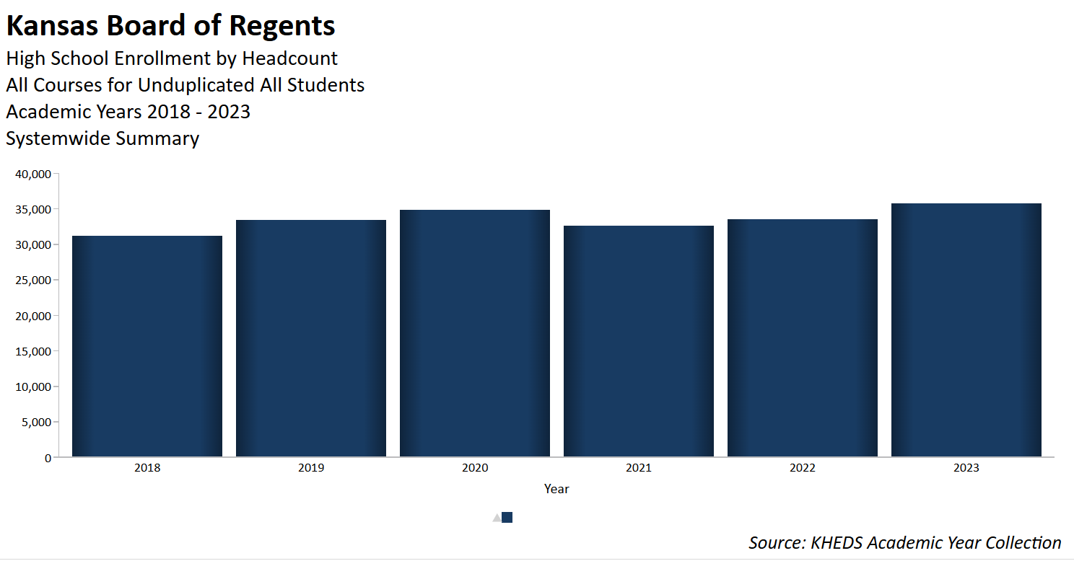
HEADCOUNT ENROLLMENTS AY 2018-AY2023
33,410
34,908
33,519
35,785
31,248
32,603
Notes:
Most recent six-year trend data. 2023 reached pre-covid numbers.

Slide 6
SECTORS PROVIDING HIGH SCHOOL ENROLLMENT
Notes:
This slide provides an overview of each sector’s enrollment numbers, and the following slides provide institutional data within each sector.

Slide 7
UNIVERSITY ENROLLMENTS OF HIGH SCHOOL STUDENTS IN ALL COURSES
Notes:
Six-year trend for university enrollment numbers. For AY 2022, the state universities provided 5.3% (1761/33,520) of high school enrollments. Washburn provided 2.8% (941/33,520) of the high school enrollments. Total of 8.1% at universities.

Slide 8
COMMUNITY COLLEGE ENROLLMENTS OF HIGH SCHOOL STUDENTS IN ALL COURSES

Slide 9
TECHNICAL COLLEGE ENROLLMENTS OF HIGH SCHOOL STUDENTS IN ALL COURSES

Slide 10
HEADCOUNT PERCENTAGES BY RACE/ETHNICITY

Slide 11
HEADCOUNT NUMBERS BY RACE/ETHNICITY

Slide 12
CREDIT HOURS EARNED BY HIGH SCHOOL STUDENTS IN ALL COURSES
284,079
295,415
285,402
289,456
306,904
265,742

Slide 13
PERCENTAGE OF CREDIT HOURS EARNED BY RACE/ETHNICITY

Slide 14
NUMBER OF CREDIT HOURS EARNED BY RACE/ETHNICITY

Slide 15
COMPLETION AND RETENTION OF HIGH SCHOOL STUDENTS 3 YEARS AFTER HIGH SCHOOL GRADUATION
Notes:
How successful are the high school students after high school? The Student Success Index measures success after high school graduation. Student Success Index for ALL students who took a college-level course while in high school. The Total Success Rate indicates the percentage of students who completed or are still enrolled/retained in higher education three years after high school graduation. The SSI includes a filter of how many college-level hours were taken in high school. This chart includes all hours. This particular chart shows after three years, but the options include from 1-8 years after high school graduation.

Slide 16
QUESTIONS?
Please contact Karla or Judd with questions
Karla Wiscombe, kwiscombe@ksbor.org
Judd McCormack, jmccormack@ksbor.org
Kansas Higher Education Statistics KHEStats

