Slide 1
Kansas Board of Regents
Clinical Integration Update
Doug Girod, M.D.
Executive Vice Chancellor, KUMC
Bob Page
CEO, University of Kansas Hospital
December 17, 2014

Slide 2
Goals
What is the Medical Center?
Missions
Challenges
Current state
Future state (Clinical Integration)

Slide 3
KU Medical Center – Who are we?
Kansas City Campus
  KU Medical Center
  University of Kansas Physicians Group
  University of Kansas Hospital
    KU Cancer Center - Fairway
    Indian Creek Campus - Leawood
    KU MedWest - Shawnee
    KU Sports Medicine – Arrowhead Stadium

Slide 4
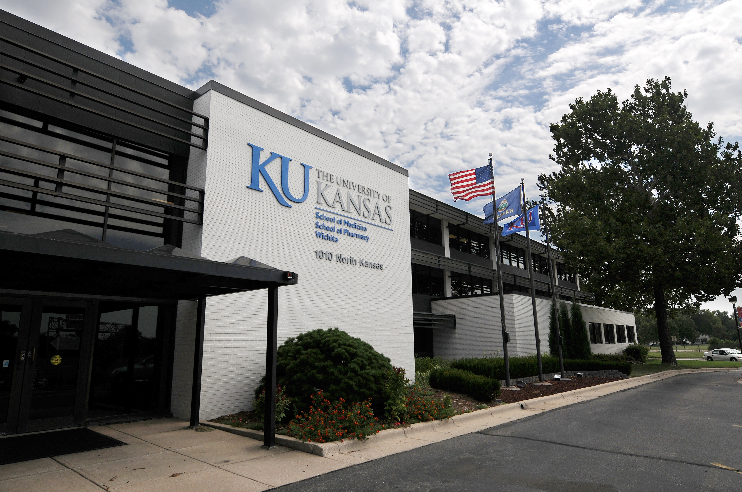
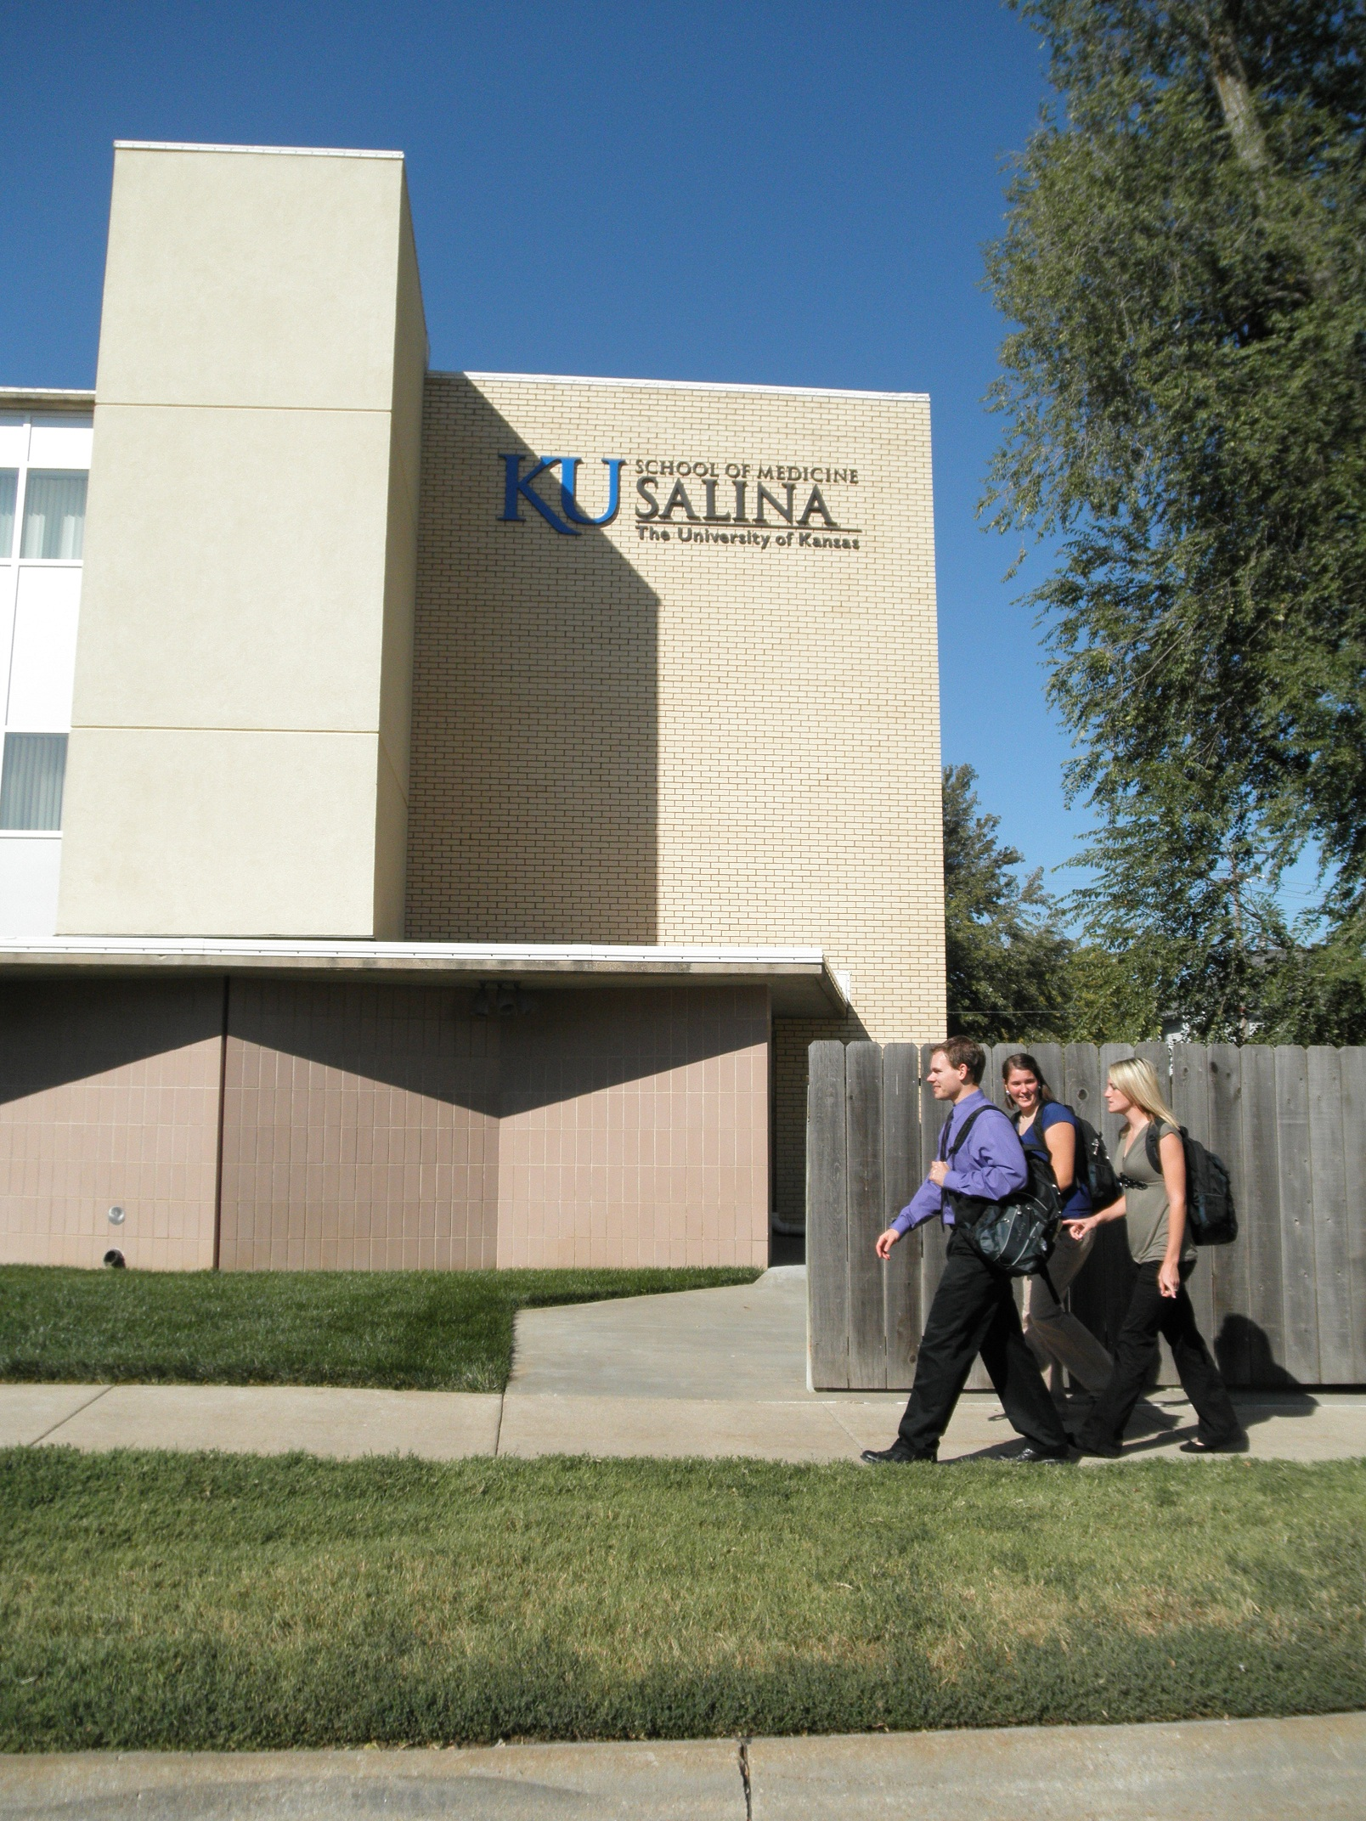
KU Medical Center
KUMC
  School of Medicine
    Kansas City
    Wichita
    Salina
  School of Nursing
  School of Health Professions
  Research Enterprise

Slide 5

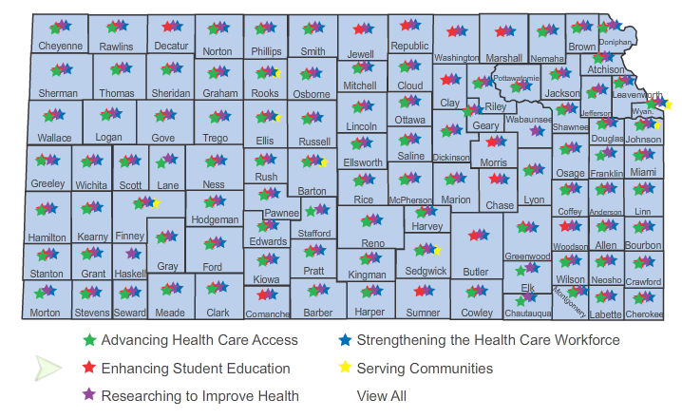
Our Missions
1. Education
2. Research
3. Clinical care
4. Community Engagement

Slide 6
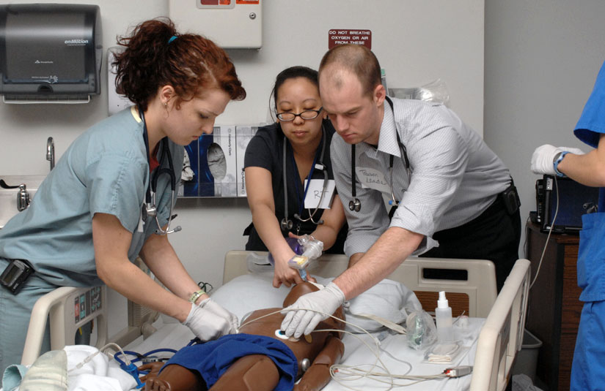
Education
KU School of Medicine: 2,059
Campuses in KC, Wichita and Salina
  M.D. program: 816
  M.D.-Ph.D. program: 30
  Residents: 797
  Graduate programs: 292
  Other programs: 124
KU School of Nursing: 681
  Undergraduate programs: 301
  Graduate programs: 380
KU School of Health Professions: 601
  Undergraduate programs: 153
  Graduate programs: 433
  Hospital-based certificate programs: 15
Interdisciplinary and other programs: 30

Slide 7
Physician Shortage Worsening
(Thousands)

Slide 8
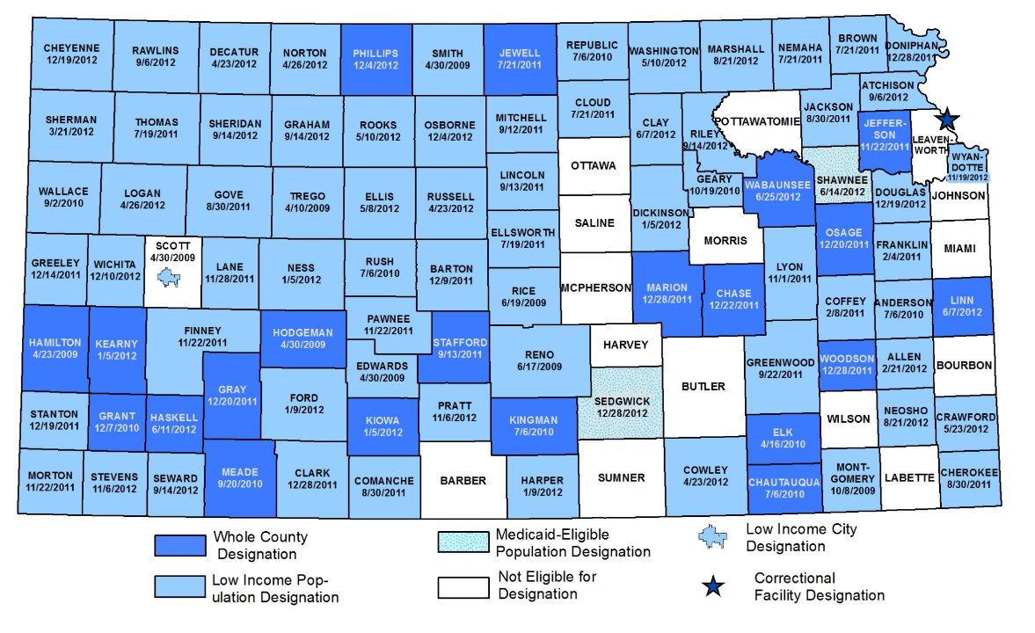
KDHE 2013 Primary Care Provider Shortage Areas
89 counties designated by KDHE as primary care health care provider shortage areas
50% of Physician shortage nationally is in primary care
39th: Kansas’ national rank in doctors per capita
30% of physicians leaving workforce in next 10 years

Slide 9
KU Health Education Initiative: Educating more doctors for Kansas
Salina
Wichita
KC
First-year
med school class size
2010
175
2011
191*
2012
211*
Proposed:
264
* Expansions made to date with no additional state funding.

Slide 10
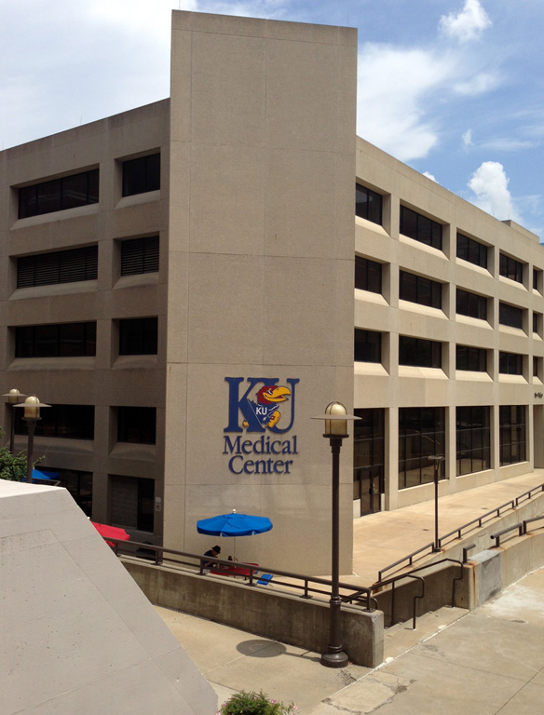
Health Education Building financing
$25 million: SGF
$25 million: Hall Family Foundation
$10 million: Philanthropy
$15 million: Tuition and other
TOTAL=$75M
X
X
KU Medical Center’s Orr-Major (1976)

Slide 11
KU Medical Center: Centers and Institutes
Cardiovascular Research Institute
Center for Child Health and Development
Center for Children's Healthy Lifestyles and Nutrition
Center for Health Behavior Neuroscience
Center for Healthcare Informatics
Center for TeleMedicine and TeleHealth
Center on Aging
Frontiers: The Heartland Institute for Clinical and Translational Research
Hoglund Brain Imaging Center
Institute for Advancing Medical Innovation
Institute for Neurological Discoveries
Institute for Reproductive Health and Regenerative Medicine
Juntos: Center for Advancing Latino Health
Kansas IDeA Network of Biomedical Research Excellence (K-INBRE)
Kansas Intellectual and Developmental Disabilities Research Center
Kidney Institute
KU Alzheimer's Disease Center
KU Clinical Research Center
KU Diabetes Institute
Liver Center
Program in Integrative Medicine
Smith Intellectual and Developmental Disabilities Research Center
University of Kansas Cancer Center

Slide 12
Research
National Institutes of Health funding for research at KU Medical Center in fiscal year 2014: $59 million
Total External funding $99 million
Research studies published by KU Medical Center faculty in journals in 2012: 929
KU Cancer Center
One of only 68 National Cancer Institute (NCI) designated cancer centers, which are at the forefront of NCI-supported cancer research efforts

Slide 13
Research
KU Alzheimer’s Disease Center
One of only 29 NIH-designated Alzheimer’s Disease Centers
Clinical and Translational Science Award (CTSA)
One of 62 medical research institutions in the national CTSA consortium, where researchers are working to speed basic-science discoveries into cures and treatments
Patient-Centered Outcomes Research Inst. (PCORI)
One of 11 Clinical Data Research Networks that are part of PCORnet, a large, highly representative, national network for conducting clinical outcomes research.

Slide 14
PCORI Funding
7 Awards for Regional Research Efforts
$22 million worth of funding over 5 years
More than ALL 6 Missouri institutions COMBINED

Slide 15
Only 21 Institutions with all three:
NCI Designated Cancer Center
Clinical and Translational Science Center Award
Alzheimer’s Disease Center Designation

Slide 16





Clinical Care
School of Medicine-KC:
Faculty physicians, residents and students provide inpatient care at The University of Kansas Hospital
Ambulatory care through The University of Kansas Physicians
School of Medicine-Wichita and School of Medicine-Salina:
Paid faculty
Volunteer faculty
Students and residents
Clinical partners:

Slide 17
Clinical Care (Kansas City)
Clinical Foundations (18)
University of Kansas Physicians
University of Kansas Hospital
NO STATE FUNDING FOR THE CLINICAL OPERATION

Slide 18
Clinical Foundations
Each Academic Department has own Foundation 501(c3)
Physician employment for clinical care
Salary, retirement, benefits
Each has governance structure, officers, BODs
Separate financials and audits
Affiliated with UKP for practice management
NO STATE FUNDING

Slide 19
University of Kansas Physicians
Clinical Practice of the KUMC faculty
501(c3) Corporation – created in the mid 1990s
  Federation of 18 Clinical Foundations (501c3)
  BOD : Dean, CEO, 3 Chairs, 6 physicians
  >750 physicians, 900 employees
  Oversight of ambulatory practices
  Centralized functions: HR, benefits, contracting, AR management, compliance, etc.
  >465,000 patient visits/year
NO STATE FUNDING

Slide 20
University of Kansas Hospital
Pre 1998 – University/State operated
University of Kansas Hospital Authority
  Public Authority
  BOD – part ex officio, part Governor appointed
  Functions as a private not for profit
  Self-sufficient
  Able to issue debt
  NO STATE FUNDING

Slide 21
KU Current State
KBOR
KU/KUMC
Board
KUSOM
H
Board
MASKU
UKP
Jayhawk Primary Care
MAC
Mid America
Thoracic & CV
Surgeons
Board
Board
Board
Board
Board
Foundation
Foundation
Foundation
Foundation
Foundation
Board
Board
Board
Board
Board
Foundation
Foundation
Foundation
Foundation
Foundation
Board
Board
Board
Board
Board
Foundation
Foundation
Foundation
Foundation
Foundation

Slide 22
Rapidly Changing Environment
Education
Research
Clinical Care

Slide 23
Challenge: Education Environment
Medical Education is expensive!!
  Fully loaded cost:
    MD = $498,000
    $125,000/year
Funding for Medical Education is limited
  Tuition (KU MD program $35,000/year)
  State General Fund support

Slide 24
State Support
State funding remains below pre-recession levels
$121.9M
$109.6M
$92.2M
State General Fund Operating Expenditures – KU Medical Center
(Not adjusted for inflation)
Note: Data includes $5 million in appropriated funds for the Cancer Center from FY 2007 – FY 2014,
including the period from FY 2012 to 2014 where the funding was provided by the Department of Commerce .

Slide 25
State Funding
Inflation outpacing state support
$159.0M
31% Reduction
$109.6M
Higher Education Price Index-adjusted State General Fund
Operating Expenditures – KU Medical Center
Note: Data includes $5 million in appropriated funds for the Cancer Center from FY 2007 – FY 2014,
including the period from FY 2012 to 2014 where the funding was provided by the Department of Commerce .

Slide 26
Limited ability to fund raises through tuition increases
State
Appropriation
29%
Tuition
11%
3,400 enrollment vs.28,000 students on the Lawrence campus.

Slide 27
Research Environment
NIH Budget
  Rapid expansion (1998 – 2003)
  Leveling
  Sequestration/Inflation

Slide 28
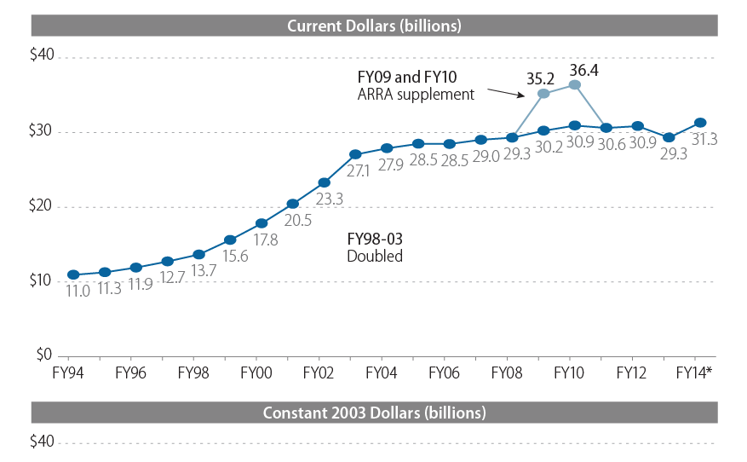

Slide 29
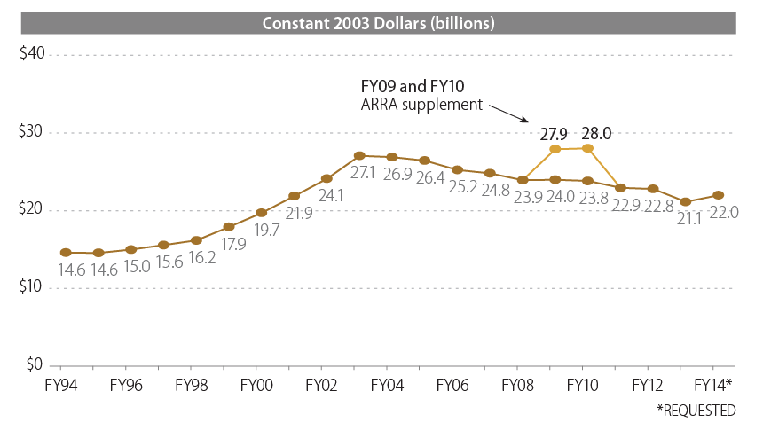

Slide 30
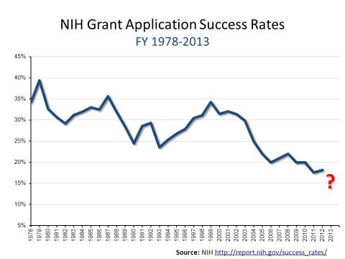
A Perfect Storm
Funding levels lowest levels in history (9-15%)

Slide 31
Response to Challenges:
Education and Research

Slide 32
State Funding
Inflation outpacing state support
31% Reduction
$159.0M
Faculty: 668 (2008)
Faculty: 974 (2012)
Alzheimer’s
Disease Center
CTSA
NCI designation
$109.6M
SOM-Salina
SOM-Wichita
Faculty: 1084 (2014)
Higher Education Price Index-adjusted State General Fund
Operating Expenditures – KU Medical Center
Note: Data includes $5 million in appropriated funds for the Cancer Center from FY 2007 – FY 2014,
including the period from FY 2012 to 2014 where the funding was provided by the Department of Commerce .

Slide 34
ARRA Stimulus
(FY 2010-11)
Federal Sequestration 5% budget cut
(FFY 2013)

Slide 36
Admin Budget
45% Reduction

Slide 37
2015 U.S. News rankings
School of Medicine:
2013 2014 2015
Primary Care-public: #25 #25 #17
Primary Care-all: #35 (tie) #37 #22
Research-public: #42 #42 #32
Research-all: #72 (tie) #75 #60
Health Professions — Public:
2. Occupational Therapy
6. Speech-Language Pathology
7. Audiology
9. Physical Therapy
21. Nursing-Anesthesia
Nursing — Public:
Nursing-Midwifery
24. Nursing master’s
40% is based on reputation

Slide 38
Strategies for Success
Improved efficiencies and accountability
Leverage missions to benefit each other
Leverage technology – Wichita and Salina
Growth of the Clinical enterprise
Investments of Clinical revenue
  Clinical growth and infrastructure
  Increase faculty size (primarily clinical faculty)
  Research investments – NCI, CTSA, Alzheimer's

Slide 39
A Brief Overview of The History and Future of
The University of Kansas Hospital
Bob Page, President & CEO
The University of Kansas Hospital

Slide 40
In the Mid to Late 1990s…
Patient satisfaction was among the worst in the country
Community perception of the hospital was poor
With 33% turnover, creating and sustaining a culture wasn’t possible
Few national benchmarks made it difficult to assess quality, although we assumed we were doing ok
Inpatient volumes were declining by 5% per year, even as the Kansas City market expanded
It was predicted that the University of Kansas Hospital would lose $20M by the year 2000 and every year after

Slide 41
10/1/1998-A New Era Begins
After exploring a number of options, legislation established The University of Kansas Hospital as a Public Authority
  A new board was created to provide oversight to the organization
    14 appointed and ex officio members, many of whom were just learning about what we did
  Inherited a 1960’s vintage building in need of repair
  Obtained our own checkbook (for the first time ever)
  Transitioned 2,200 staff from the state to the authority
    wanted to believe the new structure was the right thing to do

Slide 42
We Have Done Better Than Many Would Have Expected

Slide 43
Our Guiding Formula
World Class Patient Outcomes
World Class Patient Satisfaction
+
Delivered by Competent, Committed and Engaged Staff
Strong, Sustainable Growth
Strong, sustainable Financial Performance
+

Slide 44
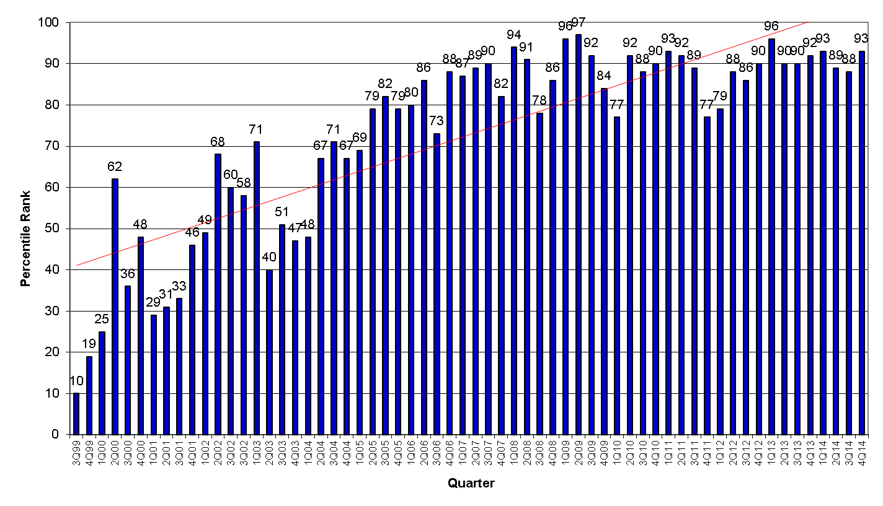
Patient Satisfaction
Quarter to Quarter Comparison

Slide 45
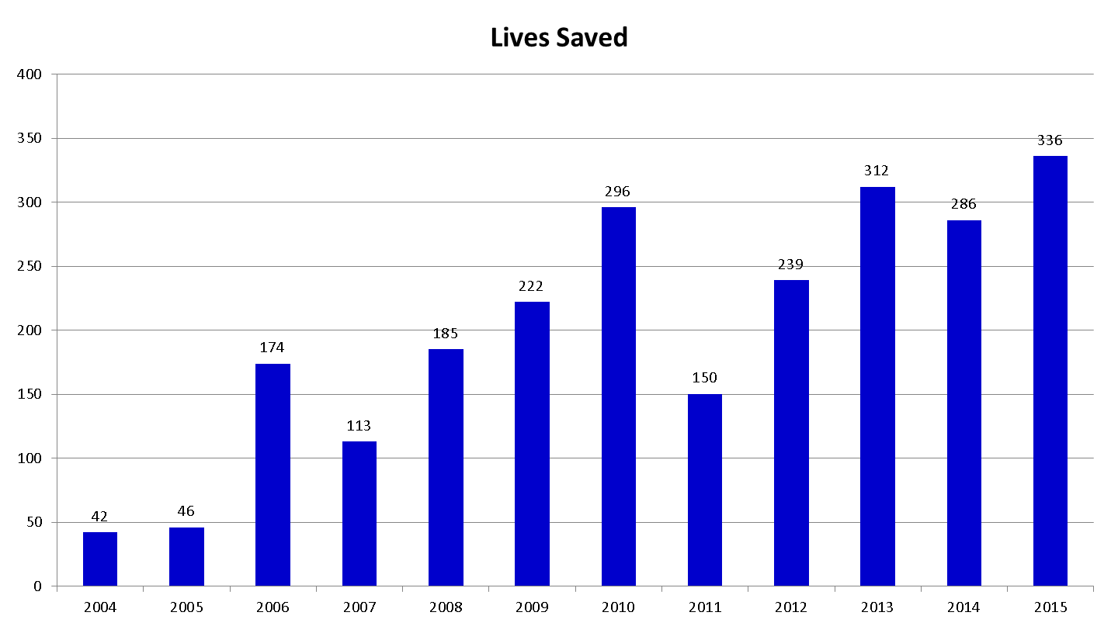
Risk Adjusted Mortality
FY15 is annualized with 4 months of data

Slide 46
UHC Overall Rank
Quality and Accountability Ranking

Slide 47












#38
#36
#33
#33
#29
#24
#21
#20
#17
#16
#12
#12

Slide 48
U S News Best Hospital Survivability & Safety Rating
For most specialties, our safety rating and survival rate is equal to or better than
Honor Roll Hospitals

Slide 49
Employee Turnover
FY14 Goal = 11.5%

Slide 50
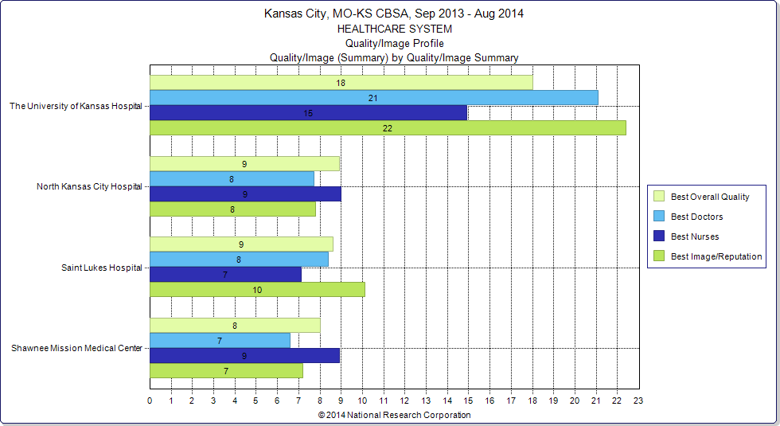
Overall Consumer Choice Measures
September 2013 – August 2014

Slide 51
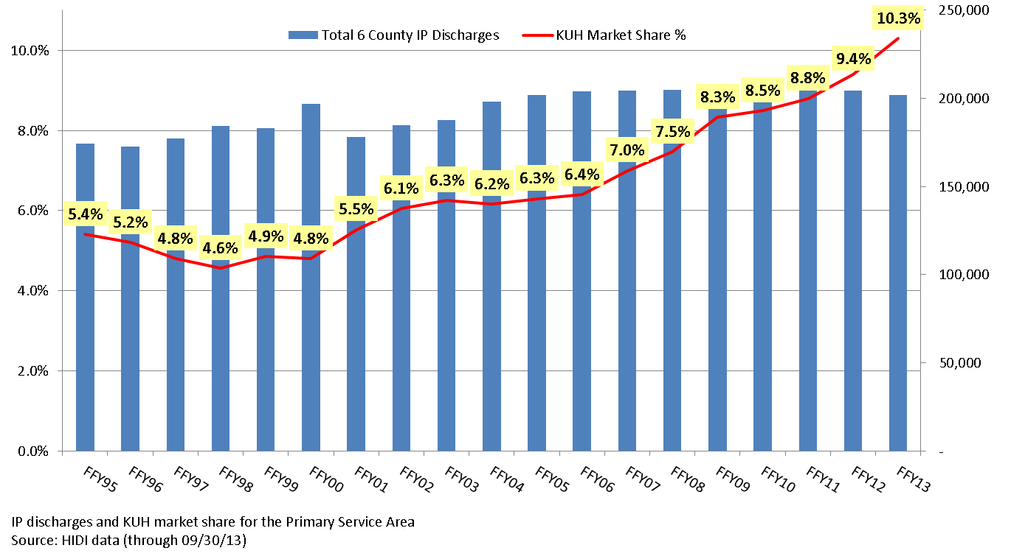
Total 6-County* Discharges and KUH
Market Share Percentage (FFY95-FFY13)
* 6 County Area: Leavenworth, KS; Johnson, KS; Wyandotte, KS; Clay, MO; Jackson, MO; Platte, MO

Slide 52
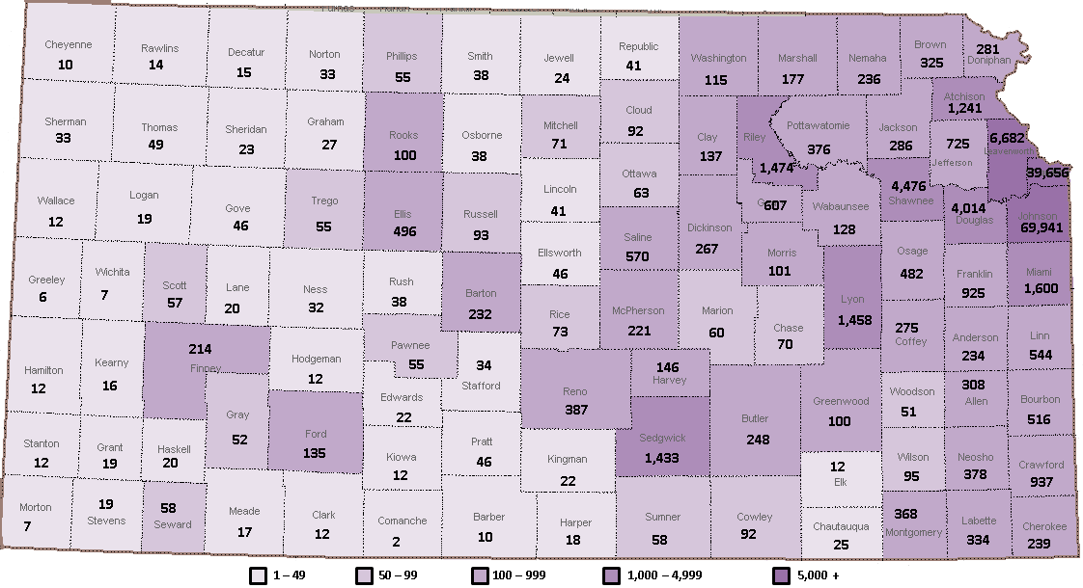
The University of Kansas Hospital and Health System Unique Patients, FY14 (Total: 146,236)
Includes all patients in the Enterprise including hospital inpatient, hospital outpatient or ambulatory setting (specialty and primary care provided by University of Kansas Physicians – UKP, Jayhawk Primary Care, Mid-America Cardiology, and other KU Hospital specialty providers)
Unique patients - patients are counted once regardless of the number of visits / encounters
11.1% increase over FY13

Slide 53
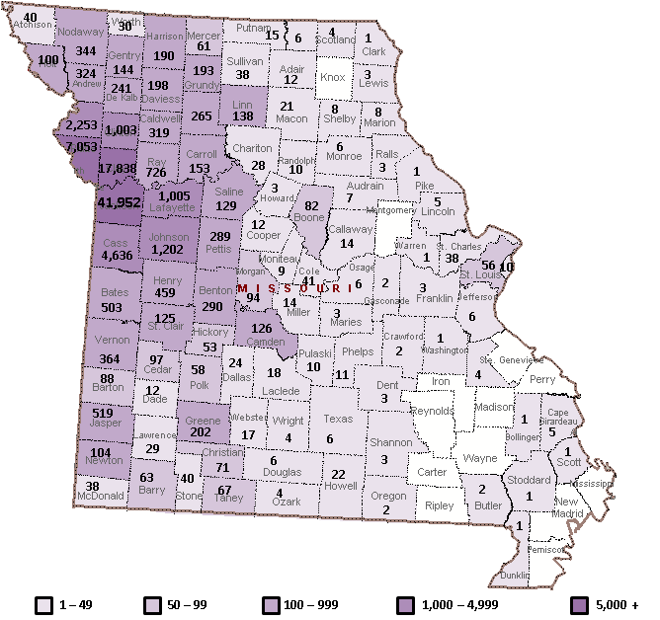
The University of Kansas Hospital and Health System Unique Patients, FY14 (Total: 84,852)
Includes all patients in the Enterprise including hospital inpatient, hospital outpatient or ambulatory setting (specialty and primary care provided by University of Kansas Physicians – UKP, Jayhawk Primary Care, Mid-America Cardiology, and other KU Hospital specialty providers)
Unique patients - patients are counted once regardless of the number of visits / encounters
14.3% increase over FY13

Slide 54
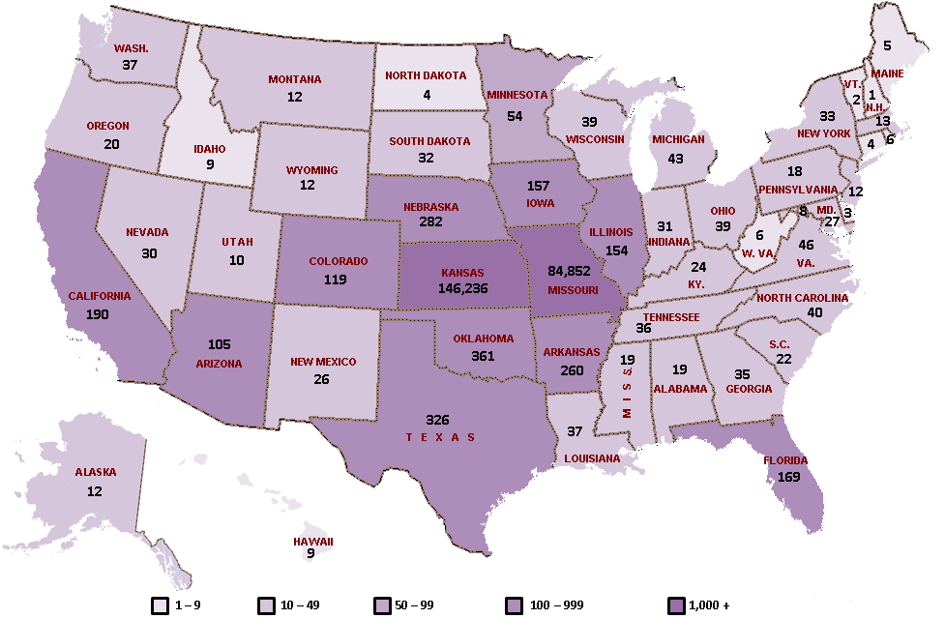
The University of Kansas Hospital and Health System Unique Patients, FY14 (Total: 234,046)
Includes all patients in the Enterprise including hospital inpatient, hospital outpatient or ambulatory setting (specialty and primary care provided by University of Kansas Physicians – UKP, Jayhawk Primary Care, Mid-America Cardiology, and other KU Hospital specialty providers)
Unique patients - patients are counted once regardless of the number of visits / encounters
17.2% increase over FY13
Notes:
Region defined as 15 county area:
• Bates, MO
• Caldwell, MO
• Cass, MO
• Clay, MO
• Clinton, MO
• Jackson, MO
• Lafayette, MO
• Platte, MO
• Ray, MO
• Wyandotte, KS
• Franklin, KS
• Leavenworth, KS
• Linn, KS
• Miami, KS
• Johnson, KS

Slide 55
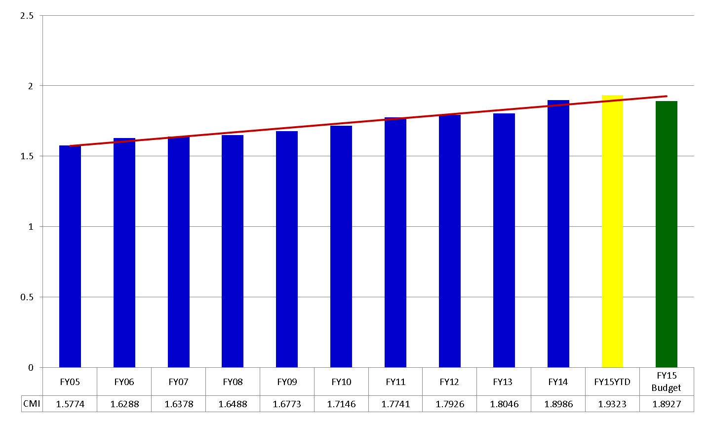
Annual CMI

Slide 56
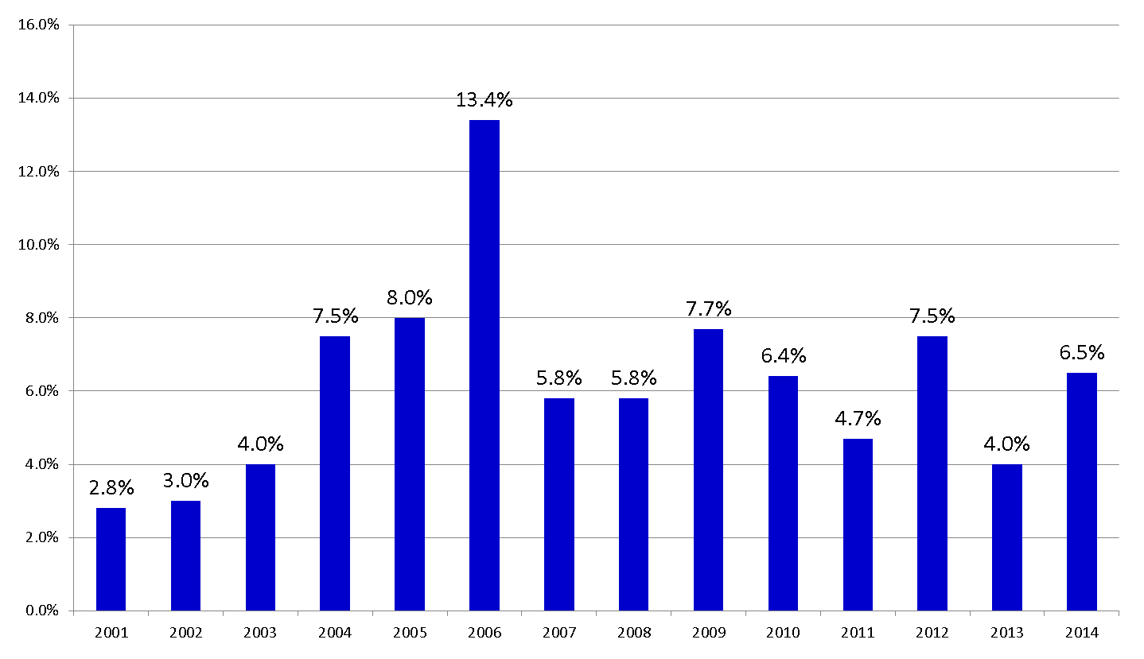
Operating Margin

Slide 57
Capitol Investment
$33
Pre-Authority: 5 years
Post-Authority: 15 years

Slide 58
AMC Greater Dependency on Clinical Income
Trends in Medical School Revenue
Revenue by Type¹

Slide 59
Medical Center Funds Flow
UKP to KUMC (Dean’s tax)
KUH to UKP (salary support, EMR)
KUH to KUMC
  Cancer center
  Cardiovascular
  GME
  Services
  Unrestricted

Slide 60
Clinical Revenue Support of AMC Challenged
Changing Healthcare environment
  Reduced reimbursement
  Loss of federal support
Increased cost
  Increased reporting
  EHR
  Labor
Complex infrastructure to manage

Slide 61
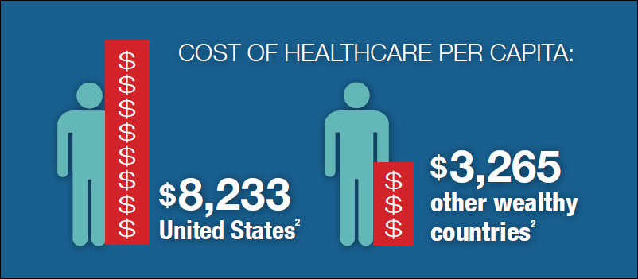
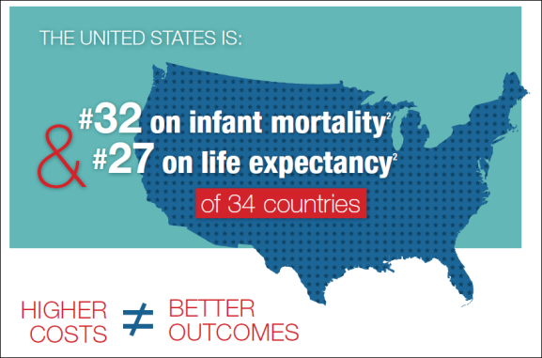
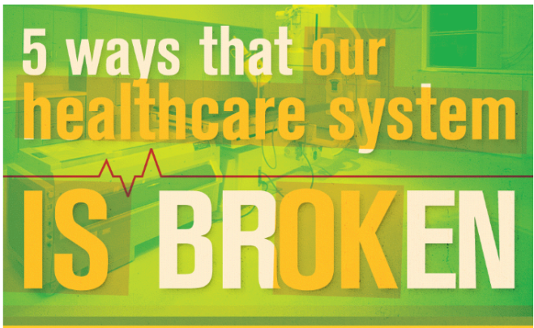

The Healthcare Landscape

Slide 62
Healthcare Cost Trends

Slide 63
Long Term Shift from IP/OP Has Accelerated
National Inpatient Days and Outpatient Visits, 1990-2012
Inpatient Days
Outpatient Visits
OP Visits % Change (’90-’12)
+125%
IP Days % Change (’90-’12)
−18%
Source: AHA Trendwatch Chartbook, 2013.

Slide 64
Progressive Shift to Value-Based Care
However, as health reform unfolds, an increased focus on integration, quality, and data transparency is coming.
2010
2015
Focus on IT/EMR implementation.
Invest in quality measurement.
Build relationships across the care continuum.
  Hospitals.
  Physicians.
  Community providers.
  Post-acute care.
  Payors.
Manage cost under changing incentives.
Ensure data transparency.
Establish bidirectional flow of clinical data (e.g., between physician and hospital).
Develop value proposition for care.
Implement new clinical and business models.
Streamline care processes.
Ensure value proposition.
Move toward a single, comprehensive patient medical record.

Slide 65


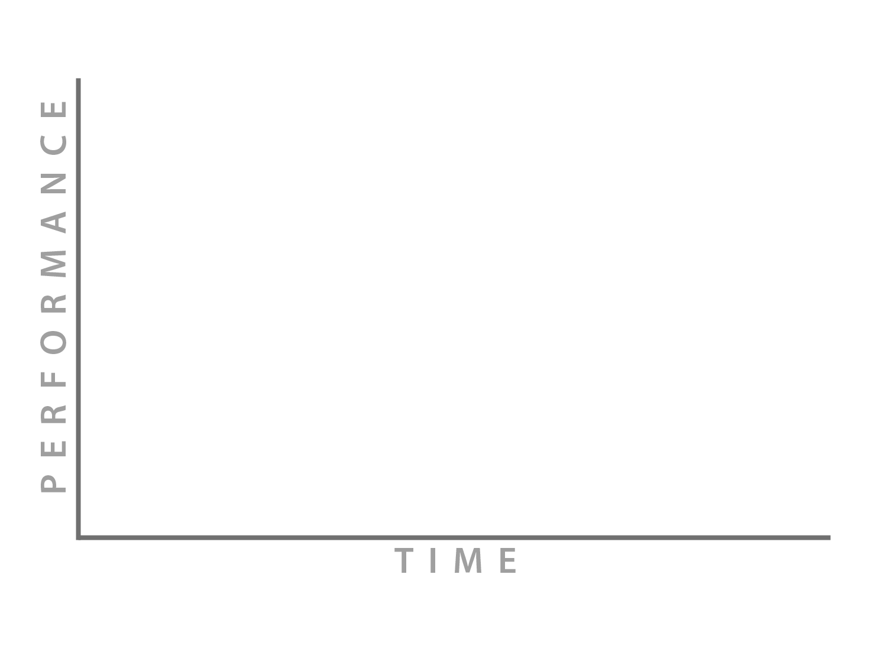
THE CURVE
First Curve
Fee-for-Service
Quality Not Rewarded
Pay for Volume
Fragmented Care
Acute Hospital Focus
Stand Alone Providers Thrive
Straddle
Second Curve
Value Payment
Continuity of Care Required
Systems of Care
Providers for Payment
IT Centric
Physician Alignment
REVENUE DROPS
MINIMAL REWARD FOR QUALITY
VOLUME DECREASES
NO DECISIVE PAYMENT CHANGE
PAY FOR VOLUME CONTINUES
HIGH COST IT INFRASTRUCTURE
PHYSICIANS IN DISARRAY
Notes:
65

Slide 66
“Health Reform” has already had an enormous impact on the healthcare industry
Total healthcare jobs lost in 2013 over 41,000!!
Recent layoff announcements
  Indiana University Health –900
  SSM Healthcare—556
  Vanderbilt—1,000
  Cleveland Clinic—unspecified, but trimming $300M from its 2014 budget
  University of Pittsburgh
  Many other hospitals and systems across the state and country

Slide 67
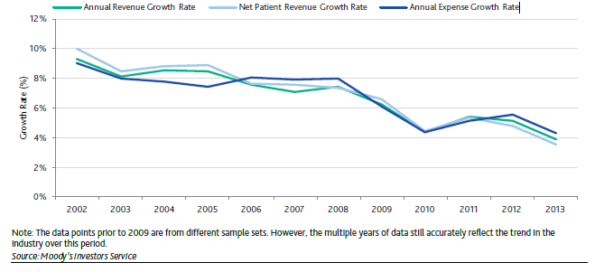
Hospital Trend: Health System Revenue Growth Continues to Slow
Moody’s expects revenue growth to remain under pressure citing (1) lower commercial rate increases (2) lower Medicare rate increases (3) increase in bad debt and lower demand for healthcare due to increase in high deductible plans (4) continued shift of inpatient admissions to outpatient settings and observation stays.
Source: Moody’s 2014 Median Report

Slide 68
3 fold Increase

Slide 69
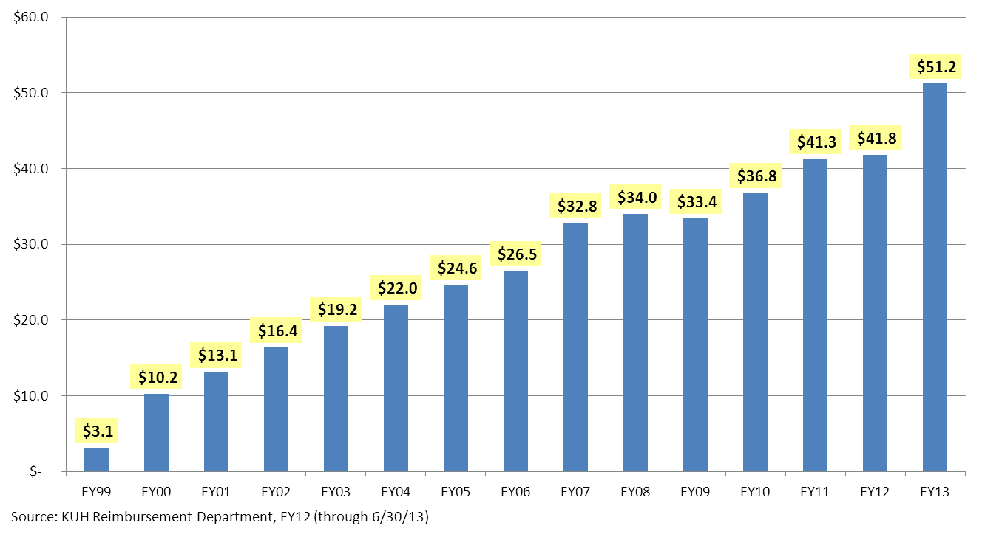
KU Hospital Uncompensated Care*
(costs in millions of dollars)
16 fold Increase
* Uncompensated care is an overall measure of hospital care provided for which no payment was received from the patient or insurer. It is the sum of a hospital's "bad debt" and the charity care it provides.

Slide 70

The Value Imperative:
Landscape Reflects Acceleration in Transformation
Citigroup Global Markets Inc. | Not-for-Profit Health Care Investment Banking
ACHE of Massachusetts Fall Conference | November 5, 2013

Slide 71
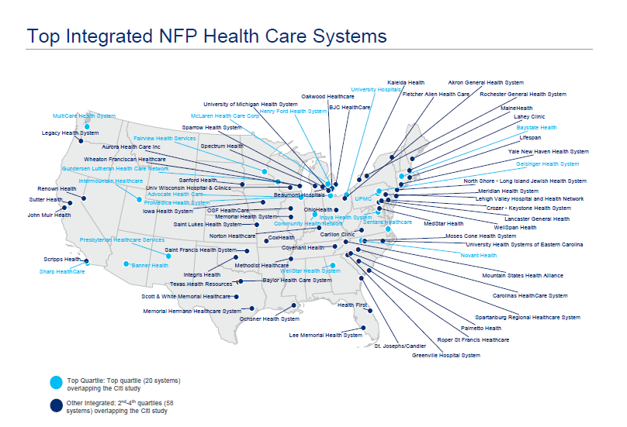

Slide 72
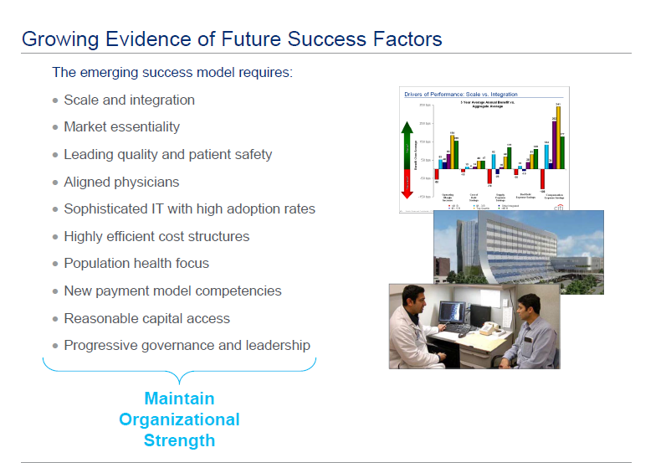

Slide 73
Physician Practice Ownership Has Flipped
MGMA found that by 2008, the share of hospital-owned practices exceeded 50%
Physicians are increasingly seeking employment in order to “lock-in incomes” in a declining reimbursement environment, shifting this risk from their practices to the hospital
Source: MGMA Physician Compensation and Production Survey Report; Wall Street Journal, “Shingle Fades as More Doctors Go To Work for Hospitals,” November 8, 2010

Slide 74
AMC Challenges
State Appropriations:
Faculty Group Practice (FGP) Professional Fees:
Freestanding Ancillary Reimbursement:
Reserves/Capital:
Discretionary Funding Within AMCs:
Sponsored Research Funding:
Market for Compensation:
Expectations of Clinical Faculty:
Competition From Non-AMCs:
Notes:
Two notable economic drivers heading in opposite direction

Slide 75
Clinical Integration: Goals
Improve/redesign patient care
Allow strategic planning and growth
Stabilize and grow the Academic missions
Align incentives across the system
Streamline funds flow and operations
Reduce redundant systems
Maximize core competencies

Slide 76

Organizational Structure Today
Board
KU
Board
KUMC
Board
MASKU
UKP
Jayhawk Primary
Care
MAC
Mid America Thoracic & CV Surgeons
Board
Board
Board
Board
Board
Board
Foundation
Foundation
Foundation
Foundation
Foundation
Foundation
Board
Board
Board
Board
Board
Board
Foundation
Foundation
Foundation
Foundation
Foundation
Foundation
Board
Board
Board
Board
Board
Board
Foundation
Foundation
Foundation
Foundation
Foundation
Foundation

Slide 77
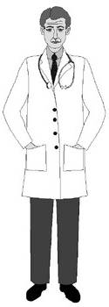
Funds Flow Today
State Appropriations
Payors
Other External Funding
Other Clinical Income
KUH
DME Pass-Through – $$
New Resident – $$
Unrestricted Support – $$
NCI – $$
Clinical Services Agreements – $$$$
Medical Administration – $$
Support Agreements – $$
Fixed Performance Bonus – $$
Medicaid Support – $$
Administrative Support – $
Strategic Investment – $
Performance Standards – $
MOB Lease $$
MOB Support – $$
NP Support – $$
UKP
KUMC
Dean’s Tax – $$
GME Support – $$
Faculty Support – $$
Clinic Support $$
PSAs
$$$$$
Medical
Administration – $$
Foundations
SOM Salaries $$$
Foundation Salaries –
$$$$ Million

Slide 78
The proposed structure will protect the three parties’ interests while not impeding core competencies
University
UKP
Hospital
Clinical Activities
Academic & Research
Core Competency
Core Competency
Common Interests and Risks

Slide 79
Two Steps in One
We are developing a closely aligned AMC and are accepting the practical barriers of a full merger of entities or of a single-AMC governance structure.
Concurrently, we are merging 18 companies and placing the PO on a path toward integration.
AMC
UKHS
Common
Governance
KUH
KUMC
Dept.
G
Dept.
A
Dept.
F
Dept.
B
UKP
Dept.
E
Dept.
C
Dept.
D
Centrally Controlled
Policies and
Finances

Slide 80

Clear Alignment and Accountability
Board
KUMC
Tight Affiliation With
New Investments
UKHS
Academic Departments
Board
Department Foundations
Department Foundations
UKP
Academic enterprise.
Better alignment of funding.
New investments for growth in UME, GME, and research.
Clear lines of accountability.
Integrated clinical enterprise with shared financial interests.
New health system with single strategy.
Single physician organization led by physicians.
Renewed physician/hospital partnership.

Slide 81
Streamlined Funds Flow Among the Entities
KUMC
GME
UKHS
Mission Support
Investments
Clinical Contracts
Other Payments
Administrative Contracts
UKP

Slide 82
Clinical Integration: Goals
Improve/redesign patient care
Allow strategic planning and growth
Stabilize and grow the Academic missions
Align incentives across the system
Streamline funds flow and operations
Reduce redundant systems
Maximize core competencies

Slide 83
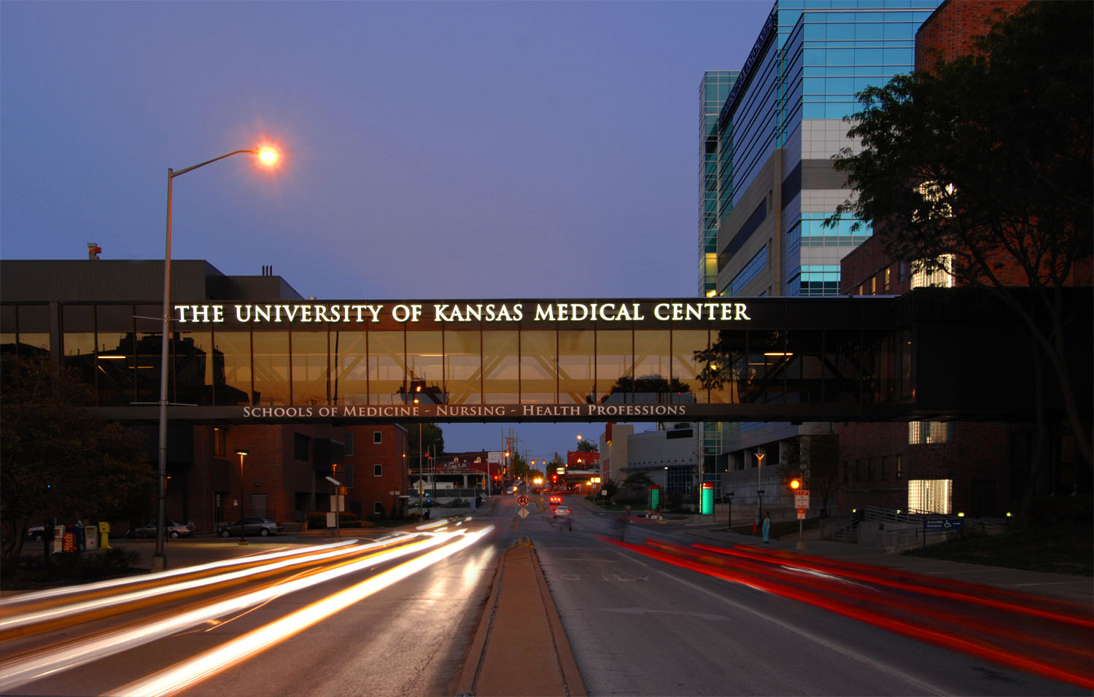
Questions?

Slide 84
Projections of Reductions to Charity Care
With Both Medicaid Expansion and Exchanges

Slide 85
Projections of Reductions to Charity Care
With ONLY Insurance Exchange

Slide 86

School of Medicine Residency Slots
Funding sources for residency positions:
Medicare
Capped at 488 slots at hospital
affiliates
Additional slots
Funded by hospital affiliates:
Via Christi, Wesley, VA,
University of Kansas Hospital, etc.
813
691
2007
2013
Cost to add 1 residency slot: $100,000 per year
First-year residency/fellowship slots open: 278

Slide 87
KUMC Legislative Priorities
FY 2016 & 2017
KUMC Budget Enhancement
  $3.4 million recurring
  Provide 3% raise to faculty/staff
  Only one 2% raise in last 6 years
  Inflation is up over 9% in the same period of time
  Tuition makes up only 11% of our budget
KU-Wichita School of Medicine Budget Enhancement
  $2.4 million in FY 2016
    Add needed faculty to meet 2011 expansion demands for four year curriculum (130 to 187 students)
  $2.5 million in FY 2017
    Further expand to 65 students/year x 4 years (260)

Slide 88
Historical Context For Wichita campus expansion
2005: Workforce Advisory Board convenes (KDHE, KAFP, KUSOM, industry)
2007: Kansas Physician Workforce Report
shows shortage and misdistribution
2008: Planning and fundraising begins for expansion
SGF operating expenditures at KUMC: $122 MM 2008
2010: Liaison Committee on Medical Education site visit in Wichita
2011: Inaugural first-year class: 8 students
-Expansion supported by $4M in private philanthropy
-Facilities expanded with School of Pharmacy addition
2012: Second first-year class: 28 students
Notes:
http://www.kumc.edu/Documents/public%20affairs/KSPhysicianWorkforceReport.pdf

Slide 89
School of Medicine - Wichita
Expansion plans
Goal:
  Full four year campus
  65 students per year
  Needs:
    Additional facilities – space analysis this year
    Additional state support – legislative ask
    Additional faculty

Slide 90
Trends in student debt
Average debt for KU School of Medicine MD recipients:
2010 | 2011 | 2012 | 2013
$129,657 | $132,987 | $141,078 | $134,999
Notes:
*Source: 2003 and 2012, Common Data Set, H5
*Source: 2004-2011, The Institute for College Access & Success, College InSight, http://www.college-insight.org. Most college-level data are taken directly from U.S. Department of Education sources and the Common Data Set (CDS). Note: 2010 data as listed reflects updates submitted to IPEDS.
Note: Applies only to those students with debt. In 2011, approximately 50% of the total enrollment has no debt.

Slide 91
Deferred maintenance – 2013
 | “Mission critical” building renewal costs | Utilities & infrastructure renewal costs
KU-Lawrence | $169,459,995 | $38,487,766
KU Medical Center | $78,844,607 | $3,769,116
KU Edwards | $2,227,279
 | $250,531,881 | $42,256,882
Kansas Board of Regents, Inventory of Physical Facilities and Space Utilization, January 2013
Notes:
“Mission Critical Building” renewal costs, page 10
Summary Calculation of Utilities & Infrastructure Renewal, page 36
http://www.kansasregents.org/resources/PDF/2355-2012DMFinalReport.pdf

Slide 92
Building replacement costs – 2013
 | “Mission critical” building replacement costs
KU-Lawrence | $1,187,356,287
KU Medical Center | $554,115,927
KU Edwards | $32,169,575
 | $1,773,641,789
Kansas Board of Regents, Inventory of Physical Facilities and Space Utilization, January 2013
Notes:
“Mission Critical Bldg. Replacement Costs”+”Mission Critical Bldg. G.S.F” page 10
http://www.kansasregents.org/resources/PDF/2355-2012DMFinalReport.pdf

Slide 93
Limited ability to fund raises through tuition increases
State
Appropriation
29%
Tuition
11%
3,400 enrollment vs.28,000 students on the Lawrence campus.

Slide 94
KUMC + UKP Budget
Faculty Salaries
900 UKP Employees

Slide 95
KUMC + UKP + KUH = AMC Budget
Hospital Infrastructure
8,000 employees

