Slide 1
Deciphering
Perkins V Data

Slide 2

2018, 2019, 2020…….wait, what year is it??
DL, NF….What does this all mean ???
Perkins V Data
Reports

Slide 3
Calendar Reminders
Currently in Perkins plan year FY21
Institutions currently reporting AY20 data
  Certification deadline 9/21/20
  Can pull follow-up report and begin work after certification
  Follow-up reporting opens 1/4/21
  Follow-up reporting closes 2/26/21
Will roll over to AY21 (Summer ‘20, Fall ‘20, Spring ‘21) at end of September
Changes to course/program inventory: wait until after certification, or make change effective after 7/1/20

Slide 4
Accountability
Core Indicators = indicators of performance
  Program performance rolls up to institutional performance
  Institutional performance targets are negotiated with the State
  Kansas institutional performance rolls up to State performance
  Kansas negotiates performance targets with The U.S. Department of Education
  Reaching State performance targets ensures that Kansas receives Perkins funds

Slide 5
Core Indicators
1P1: Placement – 2nd Qtr after exit
Still enrolled in postsecondary education
Advanced training
Military service
Peace Corps
Employed
2P1: Credential, Certificate or Degree – during recent program through 1 year after exit
(this indicator lags a year)
3P1: Concentrators in CTE programs leading to non-traditional (gender) fields
Why is KHEDS data important to Perkins V?
KHEDS Data is used to calculate core indicators and is used to distribute Perkins funds.

Slide 6
Perkins V Postsecondary Core Indicators

Slide 7
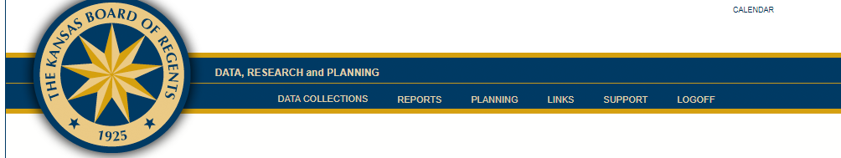
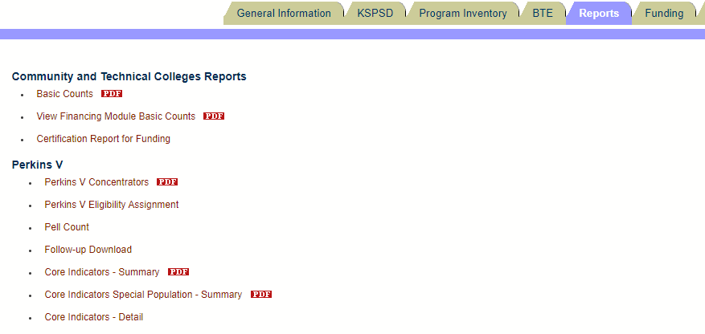

Slide 8
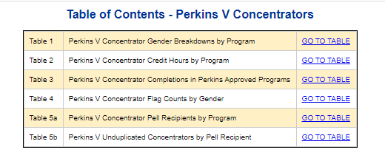

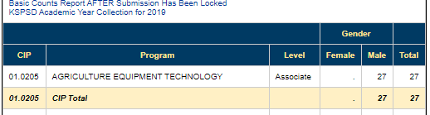

Slide 9

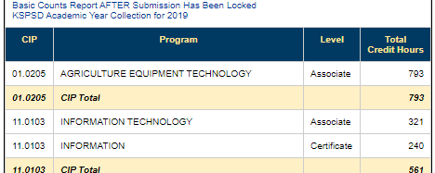
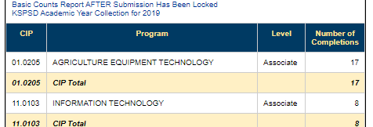

Slide 10
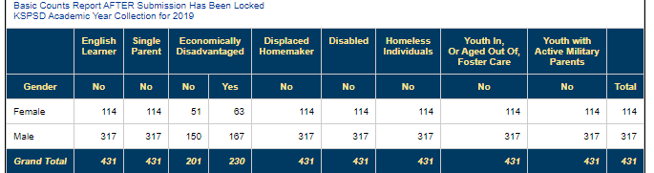

Slide 11
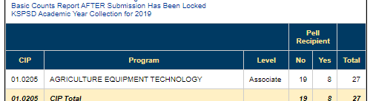
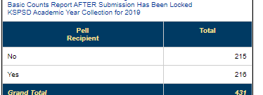

Slide 12
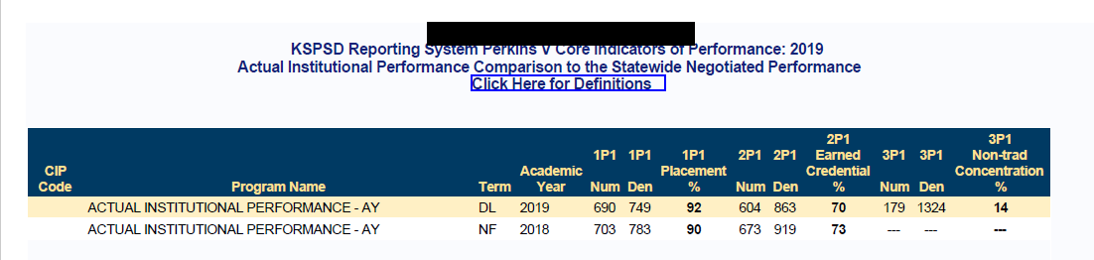
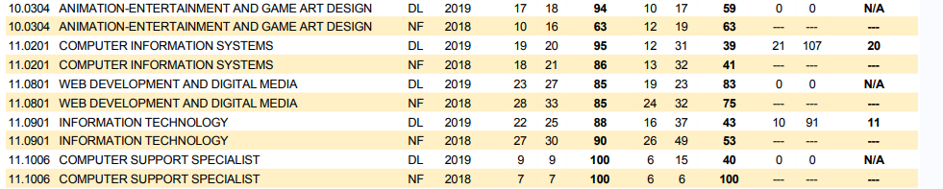

Slide 13
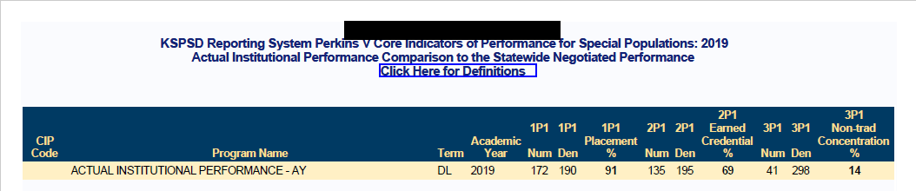

Slide 14

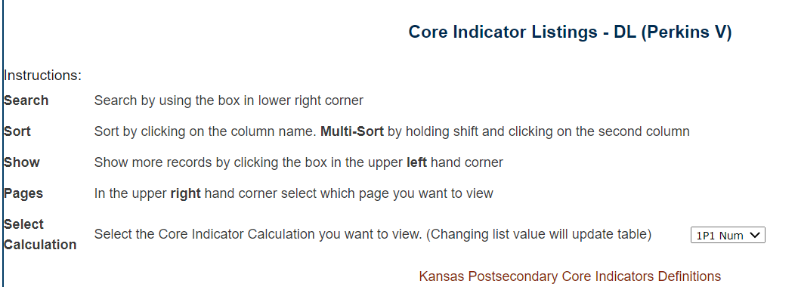
Want to know who those students are in the core indicator report? Change drop down to get numerator/denominator numbers
Can’t remember those darn definitions? Printable PDF right here
Returns these results:

Slide 15
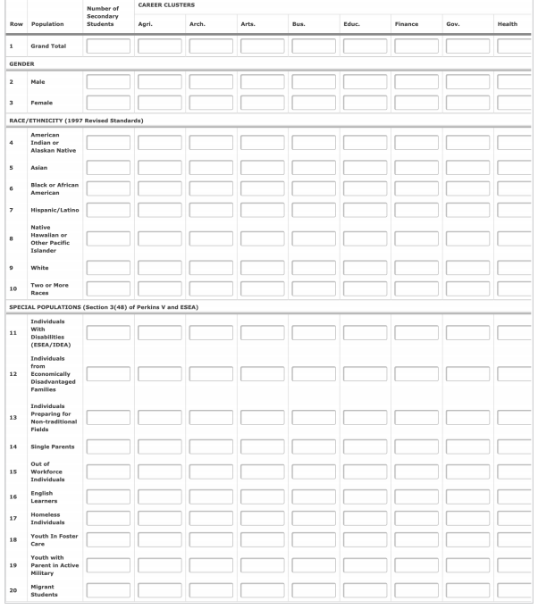
Example: Statewide Perkins reporting December 2020.
*sample only, not all columns shown

Slide 16
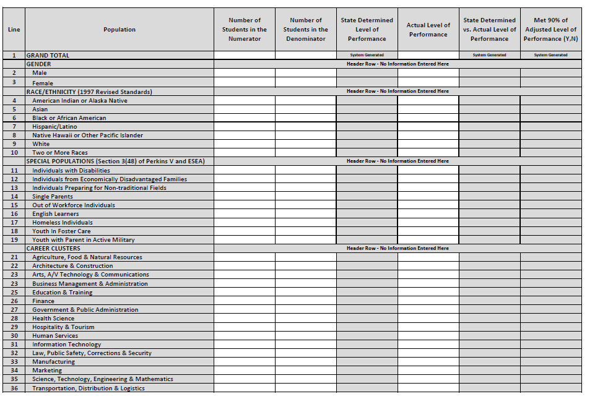

Slide 17
Wait, is it legal to ask these questions?
  Yes! When can we ask?
    When the person is a student at your institution
How should we gather this information?
What are the consequences of not collecting this information?

Slide 18
Perkins V Disclosures
The Kansas Higher Education Coordination Act, specifically, K.S.A. 74-3205d authorizes the Board to “collect and analyze data (K.S.A. 74-3205d(b)(3))” and “Compile and coordinate core indicators of quality performance for postsecondary educational institutions.” (K.S.A. 74-3205d (b)(5)).
Perkins V focuses on increasing the employment opportunities for populations who are chronically unemployed or underemployed, including individuals with disabilities. The legislation requires eligible recipients to report annually on core indicators of performance, and the data must be disaggregated by special populations with whom participants are served. One of those special populations includes individuals with disabilities.
The Board of Regents does not collect the type of disability; rather it collects a ‘yes or no’ flag as to whether the student has an impairment as defined in the Americans with Disabilities Act (42 U.S.C. § 12101 et. seq.). Data is maintained in secure databases, and only authenticated users have access to that data. Data is used for the authorized purpose: “core indicators of performance of a federal or state supported program.”

Slide 19
Performance Negotiation
2019 Summer meeting projection documents
Proposed targets to President/Perkins Coordinator
Institution reviews and negotiates targets with KBOR
Final agreed upon signed by President

Slide 21
Postsecondary Perkins Targets and Performance

Slide 22
Questions?
Additional training needed?
Perkins grant manager fall meeting – September 15, 1-3 p.m.

