Slide 1
Strengthening Career Technical Education for the 21st Century Act (Perkins V)

Slide 2
Overview
Signed into law on July 31, 2018
Kansas receives approximately $11.3 million
divided equally between KBOR and KSDE
benefits secondary & postsecondary CTE
Kansas State Plan for Career Technical Education
Transition plan: July 1, 2019 – June 30, 2020
4-Year State Plan: July 1, 2020 – June 30, 2024

Slide 3
New Focus and Goals
Career Exploration & Career Guidance
Integration of Academics and CTE
Special Populations
Work-based Learning
Secondary/Postsecondary Alignment
Professional Development
Administration

Slide 4
Special Populations (definitions)
Individuals with disabilities
Individuals from economically disadvantaged families, including low-income youth and adults
Individuals preparing for non-traditional fields
Single parents, including single pregnant women
Out-of-workforce individuals
English learners
Homeless individuals
Youth who are in, or have aged out of, the foster care system
Youth with a parent who is a member of the armed forces and is on active duty

Slide 5
Needs Assessment
Data-driven decision making
to improve quality and access
The new needs assessment:
Drives application development and spending
Takes an in-depth look at CTE
Identifies areas of improvement
Is repeated every two years
Engages stakeholders

Slide 6
Regional Team
Co-Coordinators Secondary & Postsecondary Grant Managers
KANSASWORKS - Workforce Development Partners
Secondary & Postsecondary Education Representatives
Secondary & Postsecondary Administration
Representatives of Special Populations
Counselors
Students & Parents
Community Members
Business & Industry Partners

Slide 7
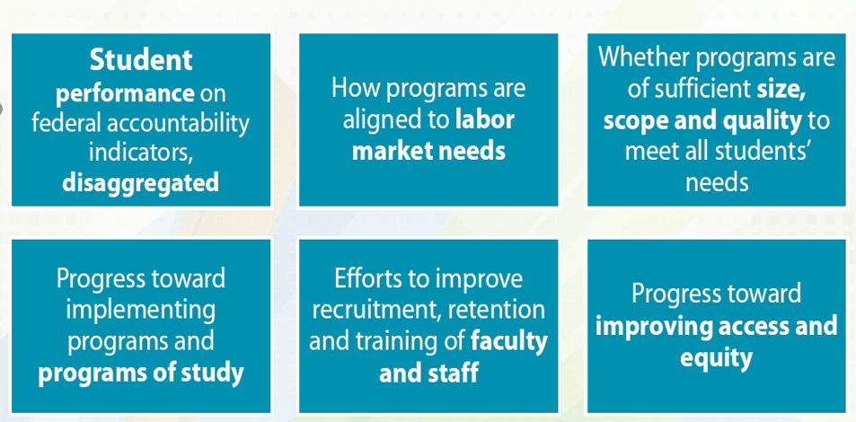

Slide 8
New Perkins V Website
www.kansasregents.org/CTE
Locate Perkins V resources
Complete Stakeholder Survey
Find contact information for Perkins V team
Submit stakeholder information & questions to PerkinsV@ksbor.org
Notes:
Labor data next

Slide 9
Next Steps for Kansas
Current – State Plan development
June & July – Launch Needs Assessment
July – Draft state determined performance levels based on new performance indicators
August/September – State determined levels of performance out for stakeholder comment
October
Workforce Innovation Conference
Seek and respond to public comment
Meet with Governor Kelly

Slide 10
Next Steps.......
November – Incorporate public comment
January – Present State Plan to:
Kansas Department of Education State Board
Kansas Advisory Council for CTE
Kansas Postsecondary Technical Education Authority
Kansas Board of Regents
KANSASWORKS State Board
February – Submit State Plan to the Governor
March – Submit State Plan to U.S. Department of Education

