Slide 1
Summer Adult Education Directors Meeting
July 27, 2020

Slide 2
Welcome and Introductions
Introduction of KBOR team
Introduction of program directors
  Introduce additional program staff
Agenda review
Virtual parking lot – what’s missing from the agenda that we need to discuss
  Share in comment section
Trivia contest

Slide 3
Trivia Question #1

Slide 4
GED Update
TOPICS
GED Stats and Updates
GED Online Proctoring
GED Prep Connect
GED Demo Account
Sue Grosdidier
High School Equivalency
sgrosdidier@ksbor.org
(785) 430-4289

Slide 5
GED STATISTICS
July 1, 2019-June 30, 2020
 | July 1, 2018-June 30, 2019 (FY 2018-2019) | July 1, 2019-June 30, 2020 (FY 2019-2020) | TOTAL CHANGES
GED.com Accts | 2,048 | 1,299 | Down 749
Approved Accommodations | 43 | 36 | Down 7
GED Tests Taken | 10,821 | 7,885 | Down 2,936
Test Takers | 3,159 | 2,491 | Down 668
Completers | 2,253 | 1,644 | Down 609
Passers | 1,883 | 1,325 | Down 558
Pass Rate | 84% (national is 79%) | 81% | Down 3%
GED Ready Tests Taken | 6,852 | 4,849 | Down 2003
College Ready | 18% | 18% | No Change
College Ready + Credit | 5% | 5% | No Change
Compulsory Approvals (Ages 16, 17) | 662 | 509 | Down 153
GED.com Accts (16, 17) | 332 | 241 | Down 91
GED Tests Taken (16, 17) | 1,468 | 1,160 | Down 308
Test Takers (16, 17) | 403 | 350 | Down 53
Completers (16, 17) | 310 | 242 | Down 68
Passers (16, 17) | 282 | 225 | Down 57
Pass Rate (16, 17) | 91% | 93% | Up 2%
GED Ready Tests Taken (16, 17) | 1,117 | 864 | Down 253
College Ready (16, 17) | 26% | 23% | Down 3%
College Ready + Credit (16, 17) | 8% | 5% | Down 3%

Slide 6
GED Information
Just FYI-transcripts thru the Money Order process are taking 5-6 weeks. Encourage people to do the online ordering.
Update on scan project

Slide 7
PREP CONNECT & DEMO ACCOUNT
Once again a reminder to check your GED Prep Connect accounts
GED now has a Demo site that walks through the opening of a GED.com account, go to https://ged-demo.gedts.xyz/signup

Slide 8
GED ONLINE PROCTORING

Slide 9
Online Proctoring-KS as of July 22, 2020
12 test-takers
9 completers
6 passers
33 total OP modules delivered thus far

Slide 10
CCRS
CCRS GUIDELINES
Participation
All instructional staff and administrative leadership should complete the Overview
Instructional staff must complete all modules for each subject area they teach
Administrative leadership must complete all modules for at least one subject area
ESL INSTRUCTORS ARE EXEMPT
All trainings must be completed within six months of hire.
Once a staff member has completed their overview and/or subject area they are not expected to repeat each year.
New Staff-contact KBOR with full name, email address and title to open a new CCRS account
Please keep KBOR updated on those that have left your organization. Accounts will be inactivated.

Slide 11
CCRS Continued
Directors will periodically receive updates on status. If you see any discrepancies, please contact Sue immediately so we can review the information.
If employees do not pass their test(s), KBOR will need to request a reset with our provider. Once the process is completed, the individual will be notified by email.
If employees are unable to gain access to their account, KBOR can reset the password, an email will then be sent with directions to proceed.
Congrats to you and your employees, 650 trainings were completed this year (July, 2019-June, 2020)
ERIC TINCHER IS ON ACTIVE DUTY WITH THE MILITARY FOR AN EXTENDED PERIOD OF TIME. DURING THIS TIME, SUE GROSDIDIER WILL BE YOUR CONTACT FOR THE CCRS TRAINING. PLEASE MAKE YOUR STAFF AWARE OF THIS TEMPORARY CHANGE.
Contact Information: Sue Grosdidier, (785)430-4289 or sgrosdidier@ksbor.org

Slide 12
Time & Effort Update
Due Dates
  Monthly
  Semi Annual (January-June), due in July
  Semi Annual (July-December), due in January
  Please double check signature dates and months.
  A signature cannot be prior to the end of the period being reported.
  If an employee has only worked a partial month, it is helpful to have this documented on the form.

Slide 13
Time & Effort Update
Please keep us in the loop when an employee leaves and the last date of employment for Time and Effort, CCRS and GED Manager.
All Time and Effort reports must be sent to: AdultEdReports@ksbor.org

Slide 14
Trivia Question #2

Slide 15
Career Navigator
Designated at each program
  Minimum of one person
  Stipend paid by state
    Avoid supplanting
    Above and beyond current duty
Connect/collaborate with:
  Local workforce system
  Local workforce board chairs
  KWSB representatives
  Local Title IV representatives
  Community/technical colleges

Slide 16
Trivia Question #3

Slide 17

Update on the Walmart Grant
Funds still available
Switching to all online instruction
Who has been able to get back into businesses?
Customized marketing materials available contact:
  Lisa Beck lbeck@ksbor.org or
  Erin Guardiola eguardiola@ksbor.org

Slide 18
AO-K @ Work Documents

Slide 19
AO-K @ Work Posters

Slide 20
AO-K @ Work Posters

Slide 21
Trivia Question #4

Slide 22
Kansas Pathway to Career
Information and materials can be found at:
  https://kansasregents.org/students/pathway-to-career-high-school-equivalency
Questions?

Slide 23
FY20 Statewide Data Review
Enrollment
FY 2019 | FY 2020 | Percentage Change
6,611 | 6,182 | -6.49%
Measurable Skill Gain
Level | FY19 | 2020 | Percentage Change
1 | 54.64% | 52.24% | -4.39%
2 | 55.09% | 51.21% | -7.04%
3 | 63.17% | 56.70% | -10.24%
4 | 74.51% | 67.10% | -9.94%
5 | 87.23% | 54.22% | -37.84%
6 | 50% | 28.57% | -42.86%
7 | 64.69% | 56.94% | -11.98%
8 | 72.60% | 69.26% | -4.60%
9 | 76.24% | 63.40% | -16.84%
10 | 71.27% | 61.52% | -13.68%
11 | 54.39% | 45.25% | -16.80%
12 | 20.83% | 0% | -100.00%
Total | 64.42% | 57.79% | -10.29%

Slide 24
Budget & Budget Forms
FY21 Budget form
  https://kansasregents.org/academic_affairs/adult-education/adult_education_resources
Lines 400, 500, 600, and 700
Modifications and Final Budgets
Budget Signatures

Slide 25
Trivia Question #5

Slide 26
Summer Adult Education Directors Meeting
July 28, 2020

Slide 27
Reflections from Day 1

Slide 28
Trivia Question #6

Slide 29
Corrections Education
Section 225 funding
AO-K in Corrections
Kansas Consortium for Correctional Higher Education (KCCHE)

Slide 30
TABE
Remote Proctoring
Pre/Post Testing
Assessment Policy Changes

Slide 31
Trivia Question #7

Slide 32
Performance Negotiations
Negotiation documents will be sent out during the first week of August.
Negotiations will include:
  Measurable Skill Gain
  GED Pass Rate
  Employment Rate 2nd Quarter
  Employment Rate 4th Quarter
  Median Earnings 2nd Quarter
  GED and Entry into PSE
  GED and Employment
  Earned a PSE Credential

Slide 33
Statewide Performance Targets
 | Negotiated FY 2020 | Negotiated FY 2021
Employment (Second Quarter After Exit) | 39.7% | 39.8%
Employment (Fourth Quarter After Exit) | 36.6% | 36.7%
Median Earnings (Second Quarter After Exit) | $4,690 | $4,700
Credential Attainment Rate | 40.0% | 40.1%
Measurable Skill Gains | 46.7% | 47.0%

Slide 34
Trivia Question #8

Slide 35
Program Best Practices
Updates from the field
  Working with corrections
  Serving students at the workplace
    United Wireless/Boothill Casino
    Tyson
    Univ of KS Health System
    Health care
    Service Sector
  Integrating Academics & CTE
  Other?

Slide 36
Anson Green, Tyson Foods
Adult ed programs vs. COVID-19
Distance Learning
Online enrollment process
Proctoring
Correctional facilities
How to keep moving forward in the face of a pandemic

Slide 37
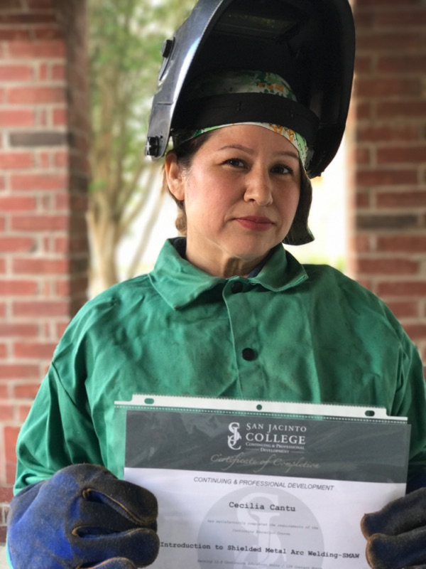
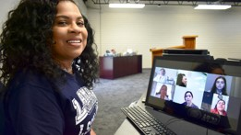
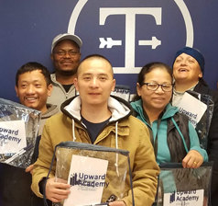
Strengthening Services through Employer Engagement and Remote Education
Anson Green
Senior Manager
Economic Opportunity
Corporate Social Responsibility
Tyson Foods

Slide 38


What are we talking about?
Partnerships with Employers
Remote Delivery for the Pandemic

Slide 39
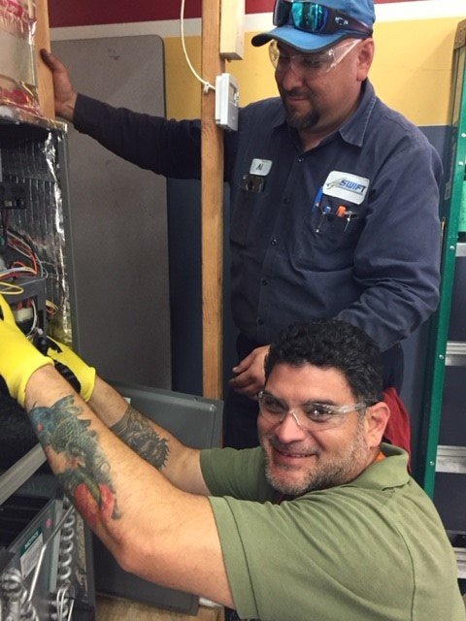
Partnerships
with Employers

Slide 40

Typical Questions
How is this funded?
Why are employers investing in ESL programs?
What do these models looks like?
What characterizes successful models?
How do I begin?
What do I need to know?
Any resources?

Slide 41
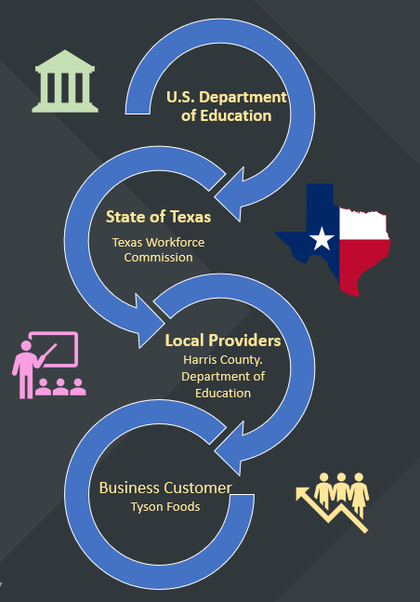
How Is this Funded?

Slide 42
Why would employers implement a workplace literacy program?

Slide 43

Reason 1
A Different Labor Market
Employers:
  Who were competing for workers are now determining what worker demand will be and upskill to new roles and processes
Are still challenged by English & educational attainment gaps
Use workplace literacy as a retention incentive and lift within organization

Slide 44
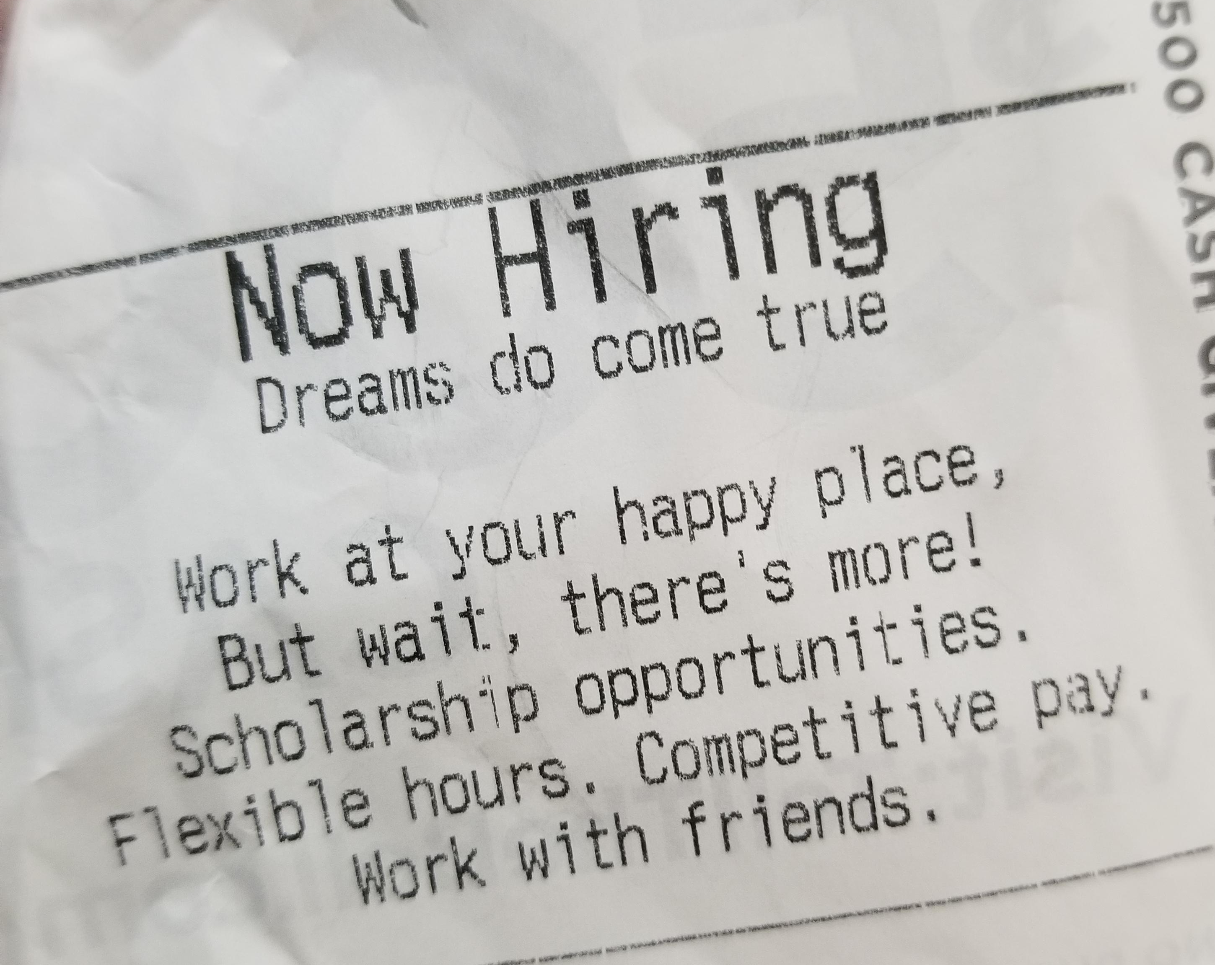
Impacts
Reason 1—Tight Labor Market (and Different)
  Baby boomers are rapidly retiring, but may now delay retirement
  Businesses:
  Need flexible talent
  Cannot buy their way out of the skills gap and remain competitive
  Are turning to outsourcing, temporary labor, automation, and recategorizing job descriptions

Slide 45

Texas Story
Reason 1— Tight Labor Market (and Different)
Texas, unlike some other states, has a young and growing population
Fueled largely by the migration of foreign workers from outside the US (well as from within the country).
Net workforce growth will be increasingly under-skilled / limited English

Slide 46
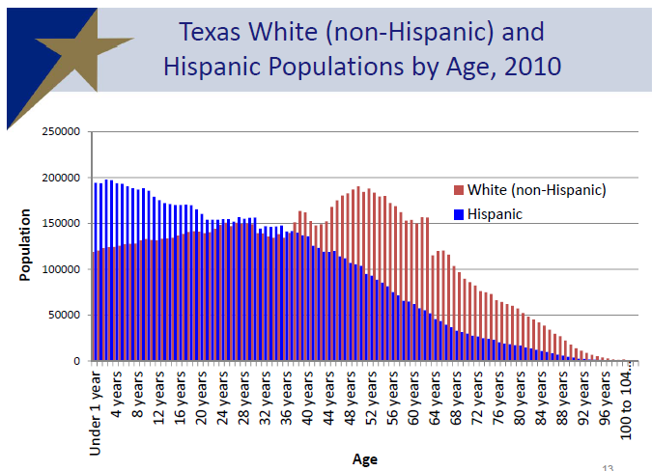
White (non-Hispanic) & Hispanics in Texas

Slide 47

Older and Retiring

Slide 48
Younger & Growing

Slide 49
SHARE OF COLLEGE
EDUCATED MEXICANS
San Antonio
11%
South Texas
12%
El Paso
13%
College Educated
18%
Of those
Entering 2013-2017
Source: A Profile of Highly Skilled Mexican Immigrants in Texas an the United States, MPI, 2019

Slide 50
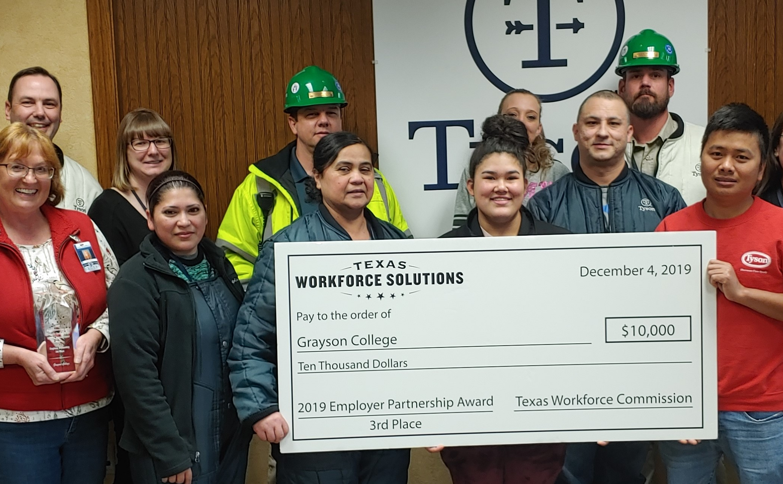
Reason 2
Grow Talent from Within
Companies desire to promote from within
Immigrant workers may have valuable language and cultural assets in diverse workplaces

Slide 51
Untapped Potential
Reason 2: Grow Talent from Within
Tenured workers are trusted, know processes, tested
Skilled immigrants with credentials maybe untapped and languishing within the company

Slide 52

Reason 3
Corporate Citizenship
Build strong communities in which they do business
Desire literate, banked, active, upwardly mobile communities
May be the largest employer in a community

Slide 53
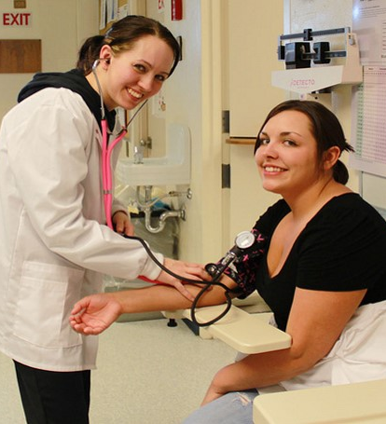
Recognizing Workplace
Literacy Programs
Often, but not always, highly customized
Optimal when held at employer worksite
During, before or after work shifts
Can be tied to employer incentives,
  promotion, or recognition
Focus on performance expectations
Require patience and flexibility and leveraged resources

Slide 54
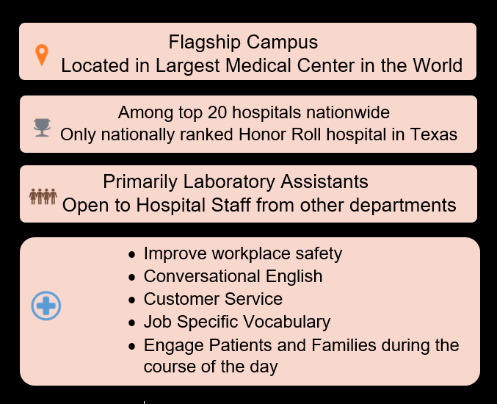
Houston Methodist
Research Institute
Ranked by U.S. News & World Report as the No. 1 hospital in Texas
Project Goals
Reinforce hospital safety protocols, philosophy, and values.
Grow talent from within.

Slide 55

Transactional to Enlightened
Same Funding - Different Results
 | OPEN COMMUNICAITON | UNDERSTAND THE NEEDS of ALL STAKEHOLDERS | CREATIVE AND FLEXIBLE | LEVERAGE EXPERTISE | REPLICABLE MODEL
MANUFACTORING COMPANY X (Transactional) | Limited meetings. Formal Communication Channels. | Not familiar with bottom lines. Difficulty aligning company needs with AE policy parameters. | Rigid and punitive. Project dynamics does not support continuous improvement or project adjustments. | SME experts limited in implementation. Unrealistic parameters and fear of failure. | Content not organized and difficult to expand Narrow and short-term focus.
MAREK CONSTRUCTION (Enlightened) | Frequent formal and informal communication. | Deep understanding of needs of each partner. Intentional development of AE and industry knowledge. | Build on previous wins. Openly discuss failures. Adjust as often as needed. Partners in learning. Solution driven. Shared | Project goals allows for AE best practices while respecting unique training practices by employer partner. | Focused on long-term project development. Develop content allowing for future cohorts with additional partners.

Slide 56
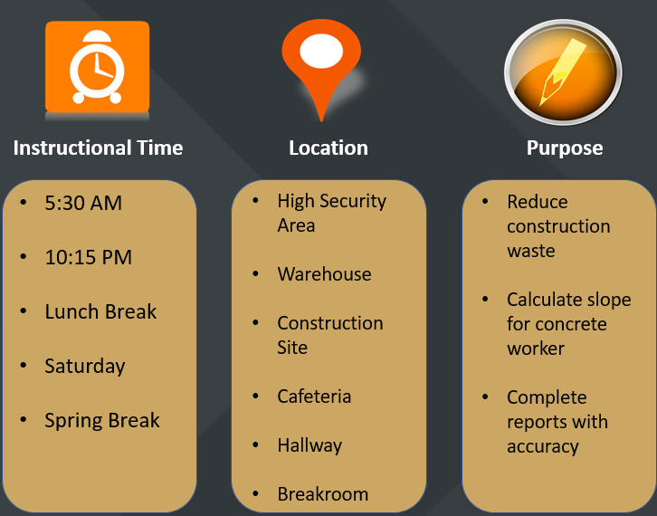
Making it Work
Innovative partnerships may require:
Nontraditional locations
Instructional times
Other classroom elements.

Slide 57



Benefits of Public-Private Partnership
It's efficient:
Leverages the expertise of each partner
It's replicable:
Scaled model with a local touch
It's empathetic:
Impacts the individual, plant and community
Notes:
Why do we partner with adult education? Benefits of a public-private partnership include:
Leveraging the expertise of each partner: We are Experts at producing food, not adult education
It is scalable with a local touch
empathy

Slide 58

How to Partner
Identify the partnership you need to develop.
“Wants” may be different than “needs.”
  Be open about what it takes to be successful.
  Go in with the intention to learn.
  Understand the needs of the employees and the employer.
  What is driving the discussion?
Creativity and flexibility are required.
“Success” may be defined differently than initially planned.

Slide 59
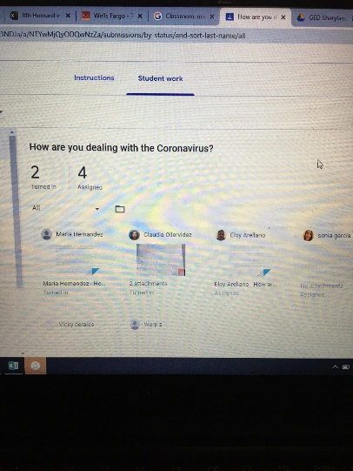
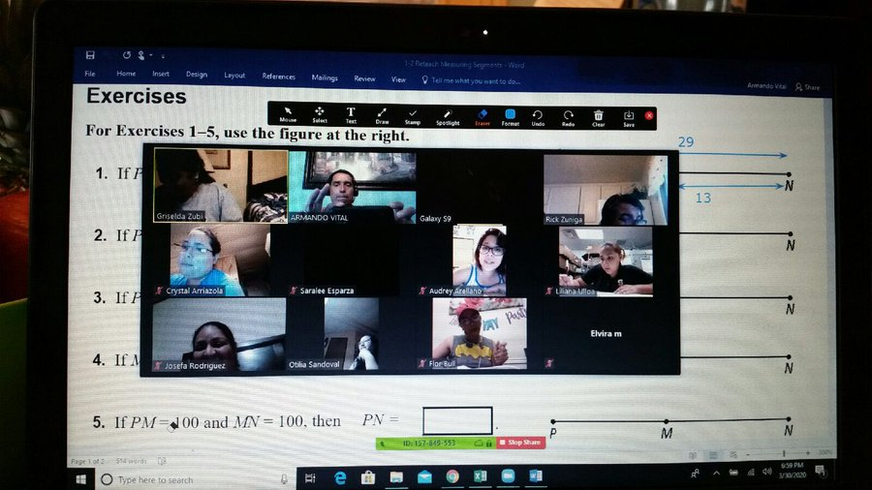
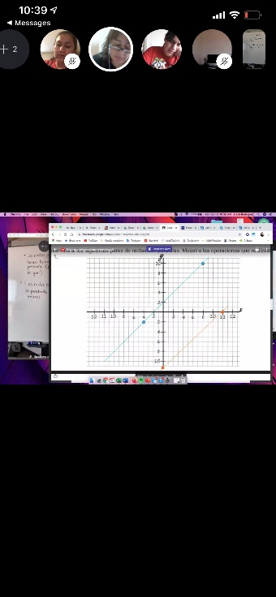
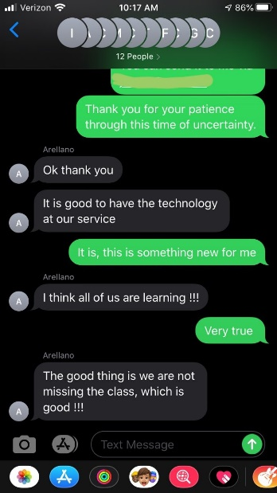
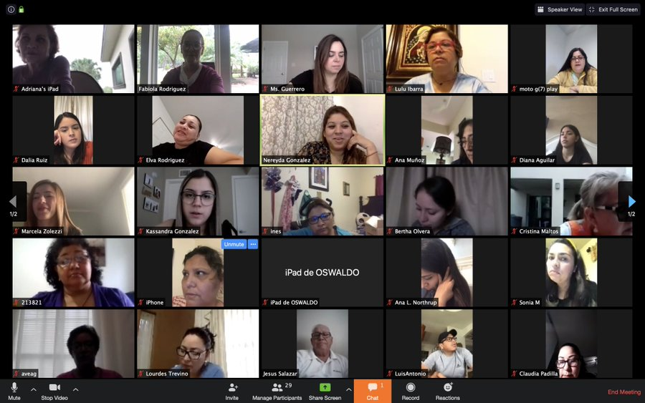

Remote Delivery for the Pandemic

Slide 60


Slide 61

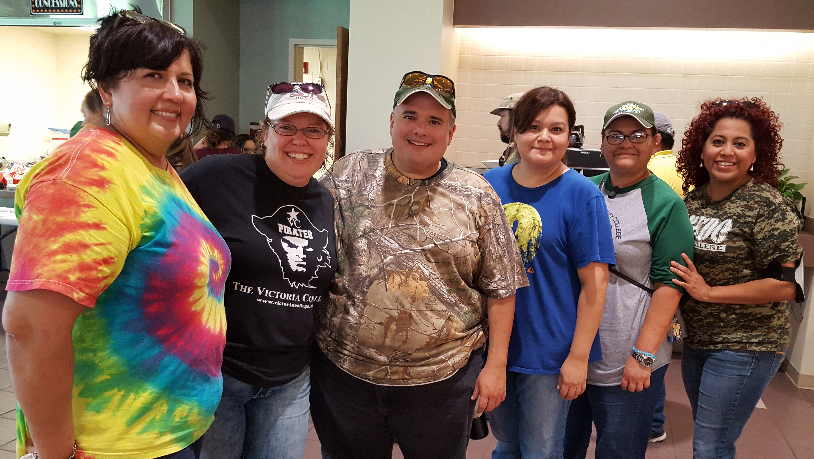
History of Disaster Response
NAFTA layoffs
9/11
Dot-com Recession
Hurricanes Katrina, Rita, Harvey
Great Recession
Today’s Great Lockdown Recession

Slide 62
Phases During Great Lockdown
Expand
Remote Options
Serving New Students
Remote Testing
Opening with Social Distancing
Notes:
3/6 Pandemic period begins
3/13 Pandemic response website released
3/18 Initial remote guidance established
3/19 Computer supply funding expanded
3/27 Guidance on serving new students at a distance
4/7 Remote testing guidance
4/14 Pandemic response funding approved
4/24 BEST 2.0 and TABE Training (1200+ staff!)

Slide 63
A Picture Says a Thousand Words

Slide 64
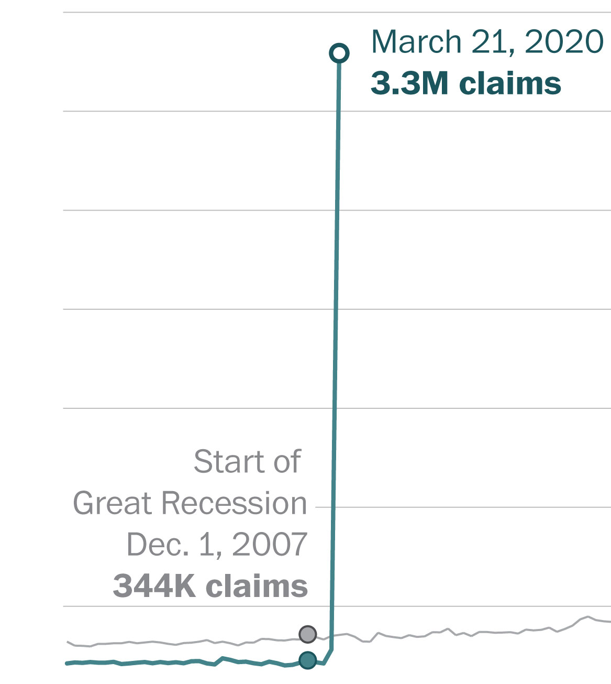
Unemployment
=
Adult Ed Growth

Slide 65

Unemployment
=
Adult Ed Growth

Slide 66
Unemployment
=
Adult Ed Growth

Slide 67
Unemployment
=
Adult Ed Growth
Potential New Students

Slide 68
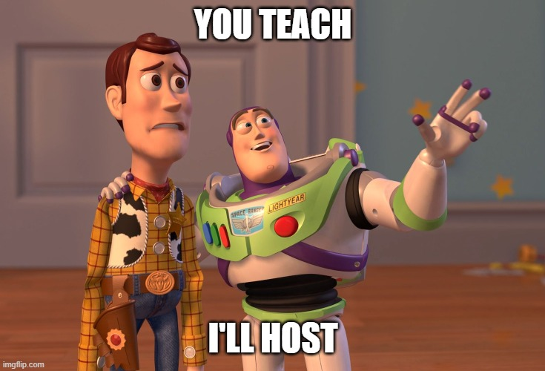
Where We Have Found Success
Consolidate classes
Pair up instructors
One-stop shopping for class links
Create how-to videos for Zoom on phones
Change instruction as little as possible for at least 2 weeks
Communicate daily with students
Evaluate
Make adjustments

Slide 69
Increasing Instructional Effectiveness
Build community in the classroom
Increase student technology comfort level
Increase Access: Tech Loaner Programs (including MiFi’s/ hotspots)
Require virtual face-to-face interaction
Make online learning as interactive as possible
Provide diverse learning materials
Offer remote tutoring sessions (including student peer tutors)
Set clear expectations and provide assessment opportunities (before, during, after)
Hold staff, teachers, and students accountable
Coordinator/Leads observe Google Classroom, REMIND, Zoom classes
Student feedback matters
  Surveys and phone calls
  Recommendations

Slide 70
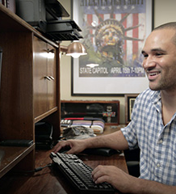
The Upside to the Lockdown
Digital literacy has become the first skill learned
Brick and mortar constraints are removed
Students appear more apt to challenge themselves
More time on task
Supervisors can monitor instruction easier and less obtrusively
Tech companies and utilities are getting more creative and opening access

Slide 71
Thank you!
Anson Green
Senior Manager
Economic Opportunity
Corporate Social Responsibility
Tyson Foods
anson.green@tyson.com

Slide 72
AESIS Review
Student Rollover
Fall AESIS Training
  September 16th, 2020 at 2:00 pm

Slide 73
Program Review, Fiscal Monitoring, and Data Quality

Slide 74
Trivia Question #9

Slide 75
Professional Development Update and Reminders
Send PD requests to Erin at eguardiola@ksbor.org
Submit requests on the provided form.
Anything involving out of state travel is currently on hold.
Reminder that when you ask for money, you need to draw it.
If we are funding something with a deliverable, we require a copy of that deliverable with the final report.

Slide 76
NEW Professional Development Opportunity
Working with Dr. Len Bogner to develop online training modules for adult education faculty
  Theories relevant to adult learning
  Instructional methods necessary to effectively instruct adult students
  Planning and delivering a lesson based on theories and methods described

Slide 77
Trivia Question #10

Slide 78
Let’s Wrap It Up!
Next steps
  Future training needs/opportunities
  How can KBOR staff assist you?
Summer 2021 meeting
Trivia winners
  Send Connie mailing address
Survey - https://tinyurl.com/y6en829z
Questions?

